Slide 1


Early Voting Started Sept 23, 2022

Slide 2
Em
IF YOU HAVE ANY ADDITIONAL QUESTIONS PLEASE
EMAIL US!
LWVARLINGTONVA@GMAIL.COM

Slide 3
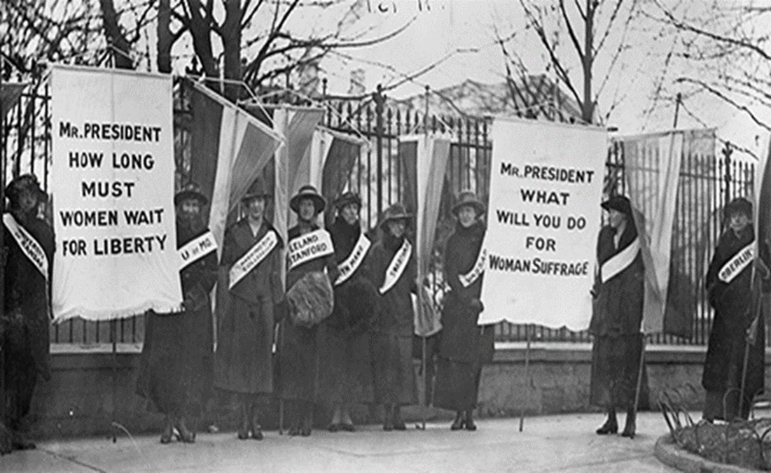
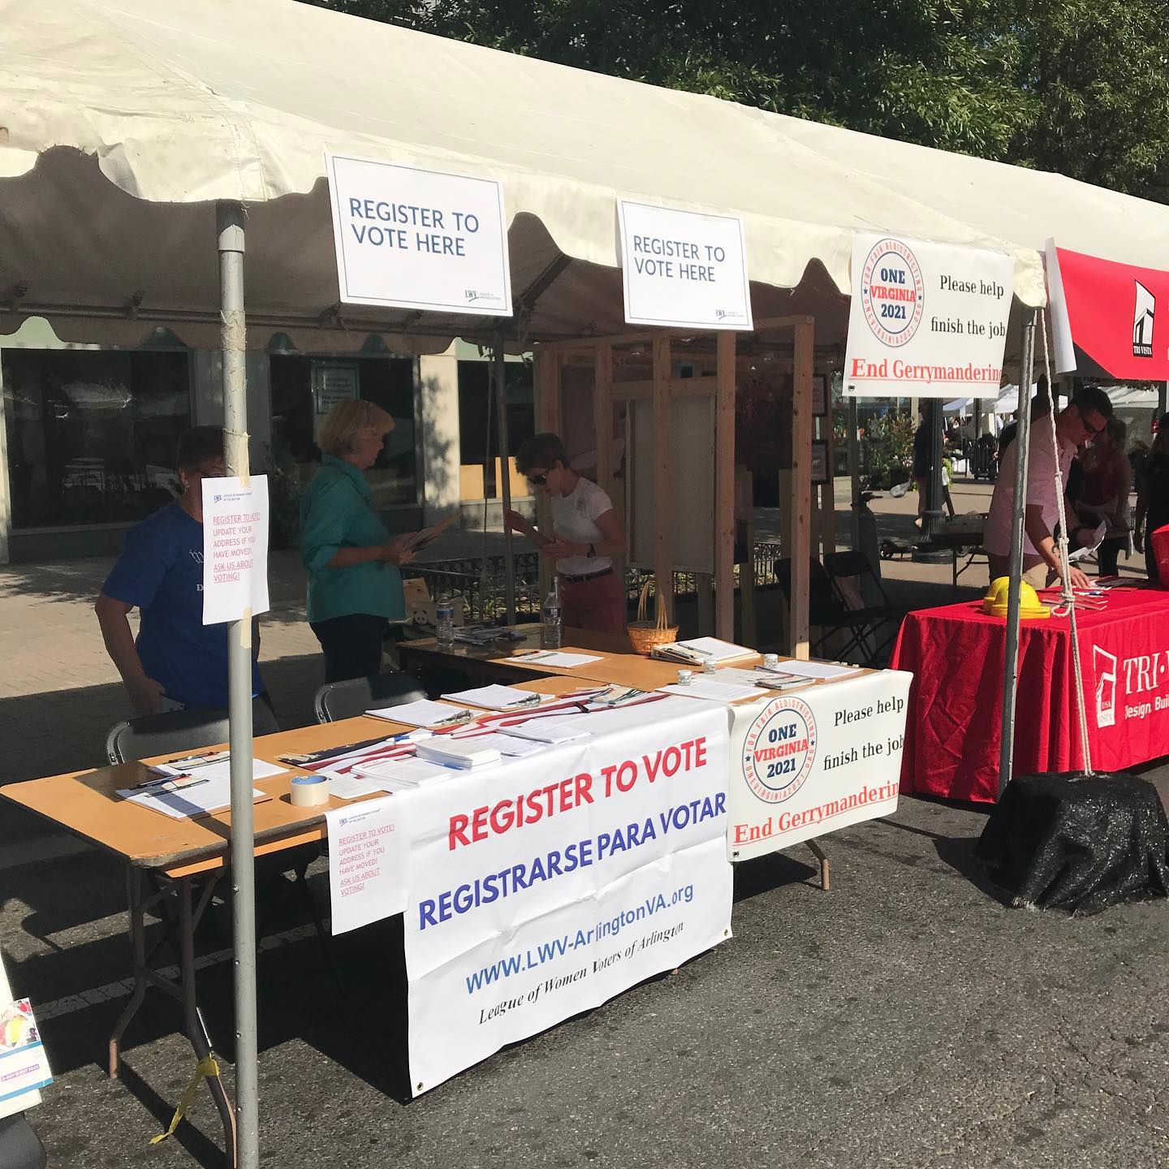
102 Year Mission to:
Empower Voters
Defend Democracy
1919
2022
Notes:
Welcome to this presentation by the League of Women Voters. In 1920, after years of advocating for the right to vote, the 19th amendment was passed. This gave women the right to vote. At that same time, the League of Women Voters was established to assist people to register to vote and provide nonpartisan information so that people could become educated voters. The goal of this PowerPoint is to help you register to vote in Virginia.

Slide 4
HOW TO APPLY FOR VOTER REGISTRATION

Slide 5
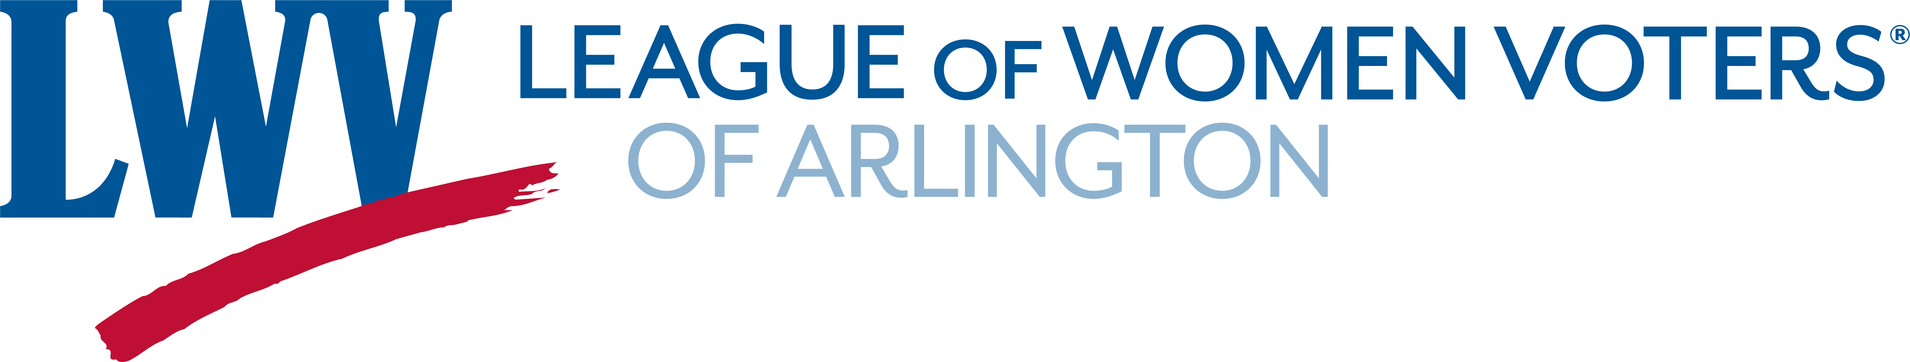
Register to Vote in Virginia if you are…
A Virginia resident
A U.S. Citizen
Are 18 years old on or before November 8, 2022
Have had your rights restored, if you have committed a felony
Have had your rights restored, if you have been judged mentally incapacitated by a Circuit Court
Update your registration if you have –to update fill out a new form
  Moved –even if across the hall or street!
  Changed your name

Slide 6

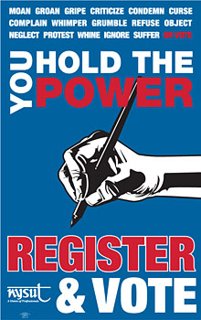
Two ways to Register to Vote in Virginia
1. Online (recommended)
2. Paper form
Deadline October 17, 2022
5:00 PM paper, 11:59 PM online
Notes:
If you are not already registered to vote, there are two ways you can do this right now. You can register online, as described in slides 6, 7, and 8. If you don’t have a driver’s license or learner’s permit, or if you would rather complete a paper registration form, you can print and complete a paper registration form as described in slides 9 and 10. If you do not have a printer, you can find paper forms in libraries, which ae open with limited hours now.

Slide 7
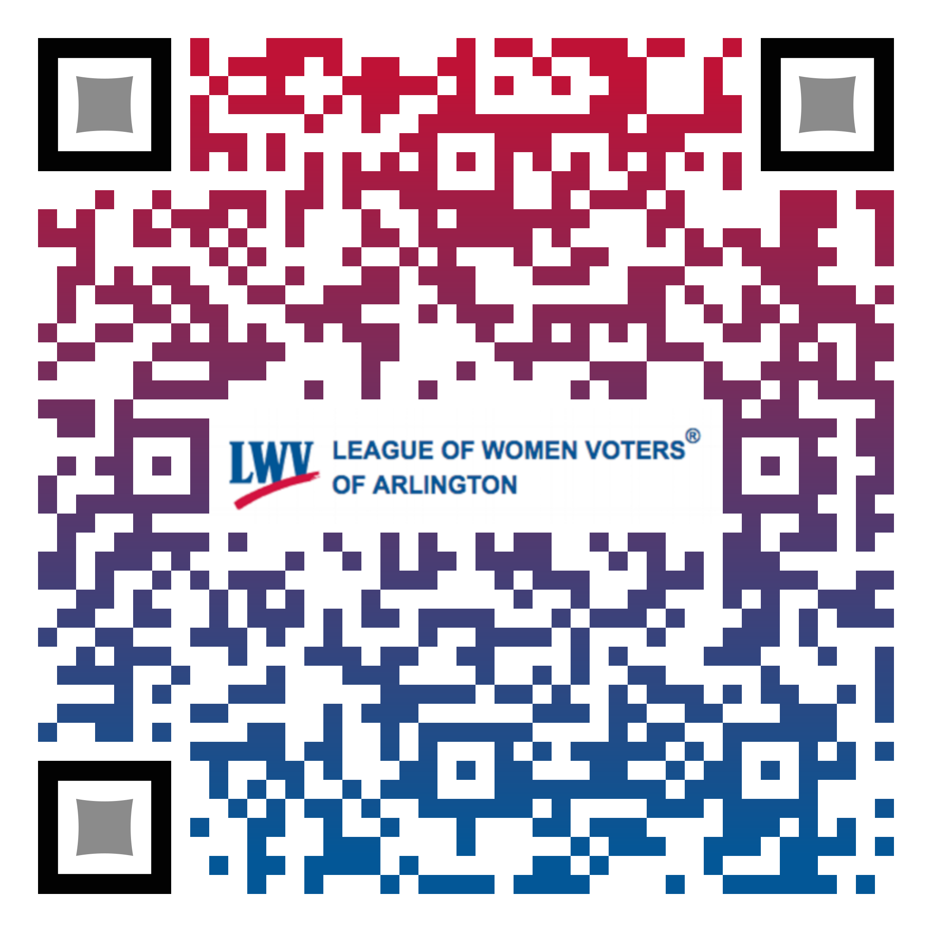
You can register online, IF you have a driver’s license, learner’s permit, or Virginia ID. You will need the customer number on your card and your full Social Security number.
Go to virginia.gov site
http://bit.ly/VoteArlington - this is good
For all Virginians regardless of where they live.
Notes:
If you have a driver’s license, a learner’s permit, or an Adult ID card from the DMV, you can register online. Click on the link at the bottom of this slide. You will see a web page that gives you choices for registering to vote or applying for an absentee ballot. Click on the Register to Vote box.

Slide 8
Information in Spanish, Vietnamese, and Korean
The Virginia Department of Elections has translated many of its web pages:
Spanish - https://www.elections.virginia.gov/es
Vietnamese - https://www.elections.virginia.gov/vi
Korean - https://www.elections.virginia.gov/ko
Notes:
If you have a driver’s license, a learner’s permit, or an Adult ID card from the DMV, you can register online. Click on the link at the bottom of this slide. You will see a web page that gives you choices for registering to vote or applying for an absentee ballot. Click on the Register to Vote box.

Slide 9
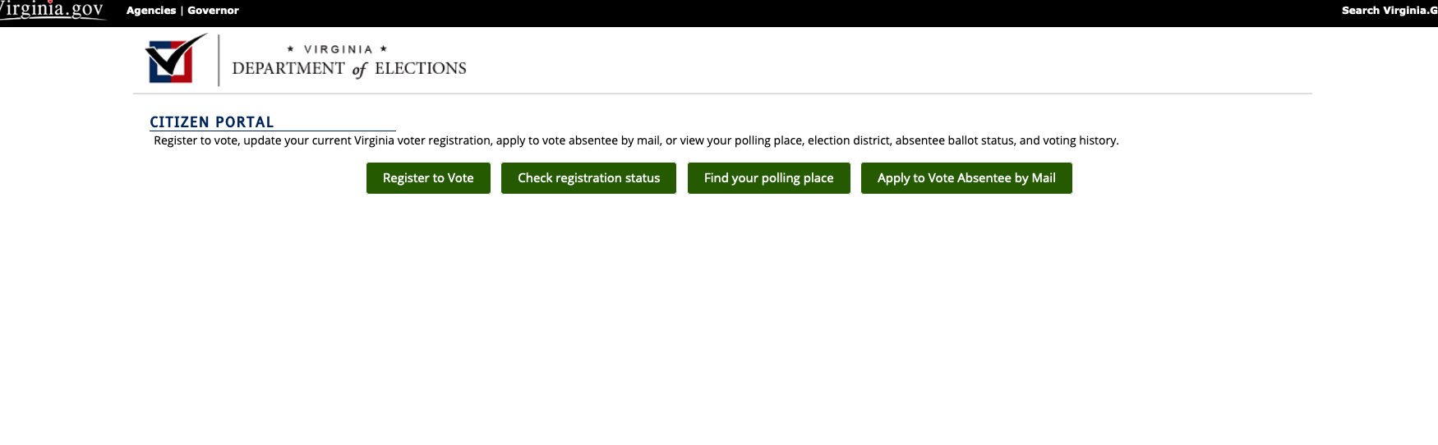
Click on the Register button.
On the next screens, accurately type all the required information.
Notes:
A registration form will appear. Be sure to complete all the boxes accurately. You will be asked for your whole Social Security number later on in the process.
You will need to say that you have read the Privacy Policy. Go to the bottom of the page and click on the link highlighted in red. Click Next to continue and Previous to go back. If you need to start over, click Reset.

Slide 10
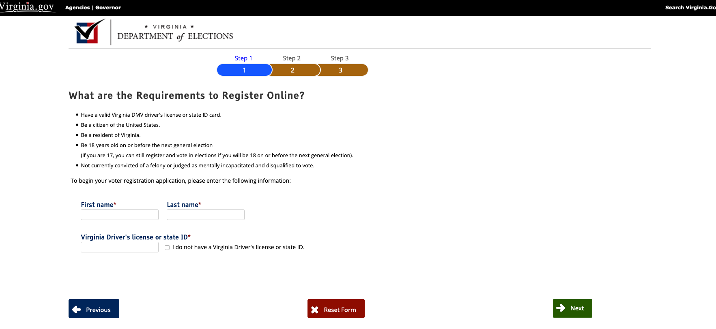

Notes:
On this screen, accurately type your social security number and your date of birth.
You must click the box below your date of birth that indicates you are providing your own accurate information and not another person’s. You are also agreeing that the information from the DMV can be used for your voter registration.

Slide 11
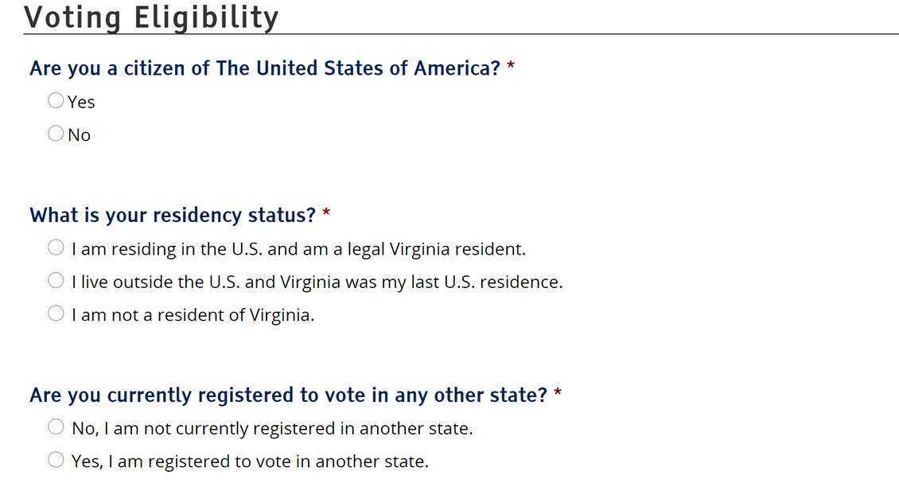
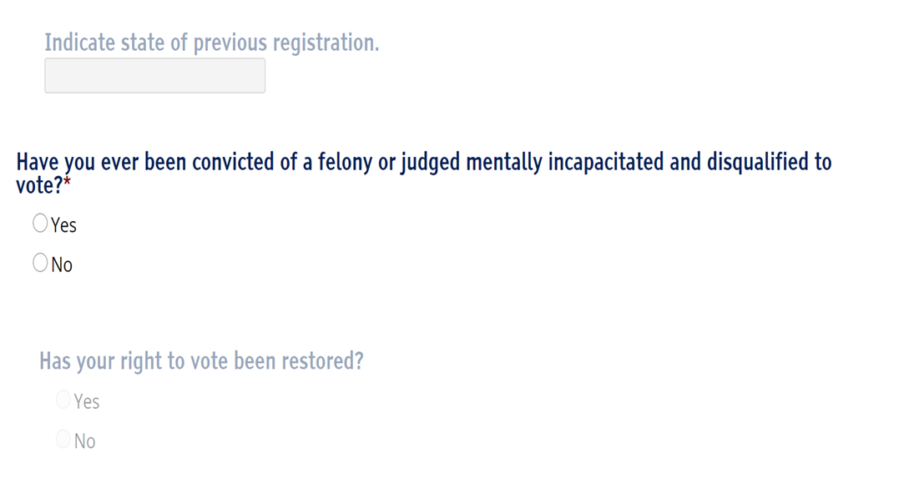
Notes:
OLD SCREEN Continue to click answers to the questions on the screen. You will be allowed to continue answering questions if your answer meets the criteria for voting in Virginia. You will NOT be allowed to continue if you do not meet the criteria based on your response.
The grayed-out words will show in black based on your answers. If you answer that you are registered to vote in another state, you must type the name of that state in the box. If you were convicted of a felony, a very serious crime, or were judged mentally incapacited, you must indicate that your right to vote has been restored.

Slide 12
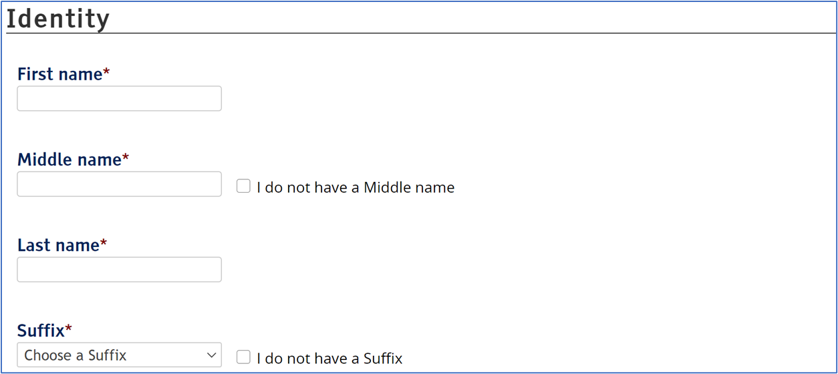
Complete this information. If this information is already filled in, check to make sure it is correct.
Your middle name must be included. If you do not have a middle name, check “I do not have a middle name.”
If you have a suffix, such as Jr. or II, please select it. Check “I do not have a Suffix,” if this does not apply to your name.
Notes:
OLD SCREEN (Read the words on the slide)

Slide 13
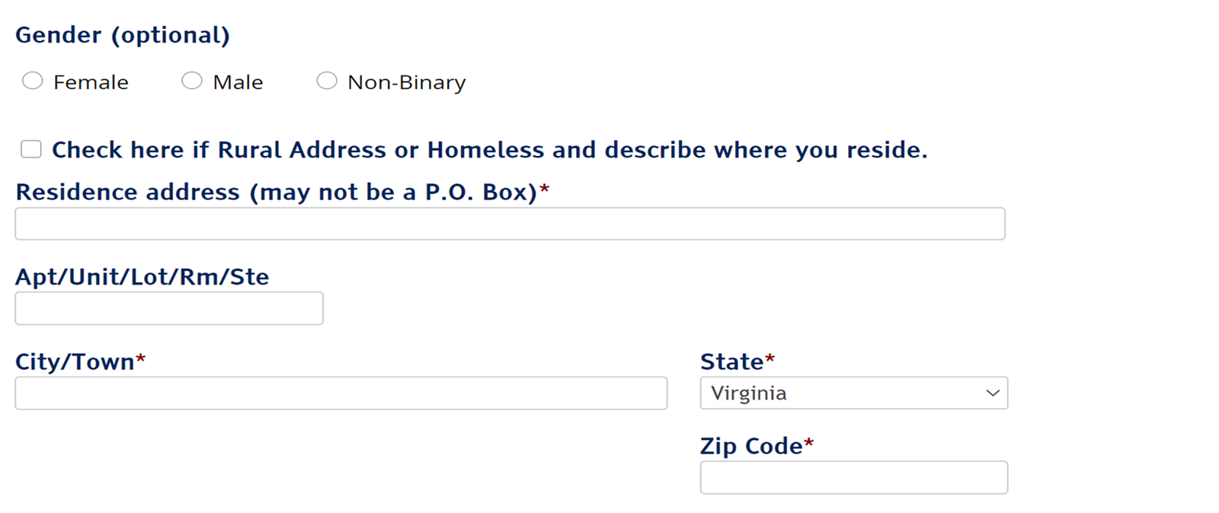
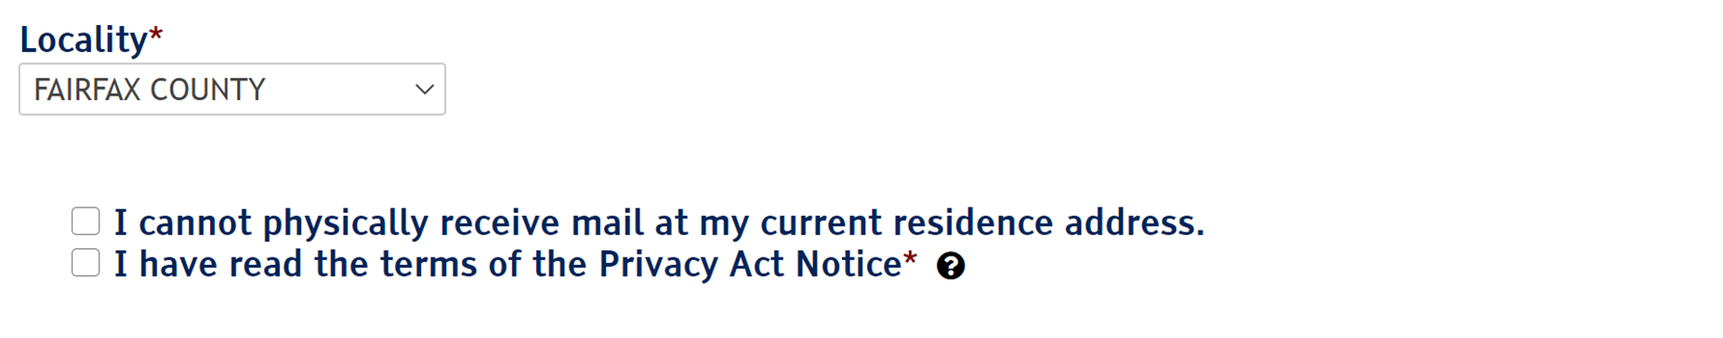
The bottom box by the arrow must be checked.
Notes:
OLD SCREEN Checking a choice under Gender is optional. You can leave this blank.
Make sure your address is correct. Make changes if it is not.
You must check that you have read the terms of the Privacy Act Notice. You can click on the question mark to read it. The Privacy Act states that your social security number will not be released to the public. It will only be used for lawful purposes, such as voter registration or jury selection.

Slide 14
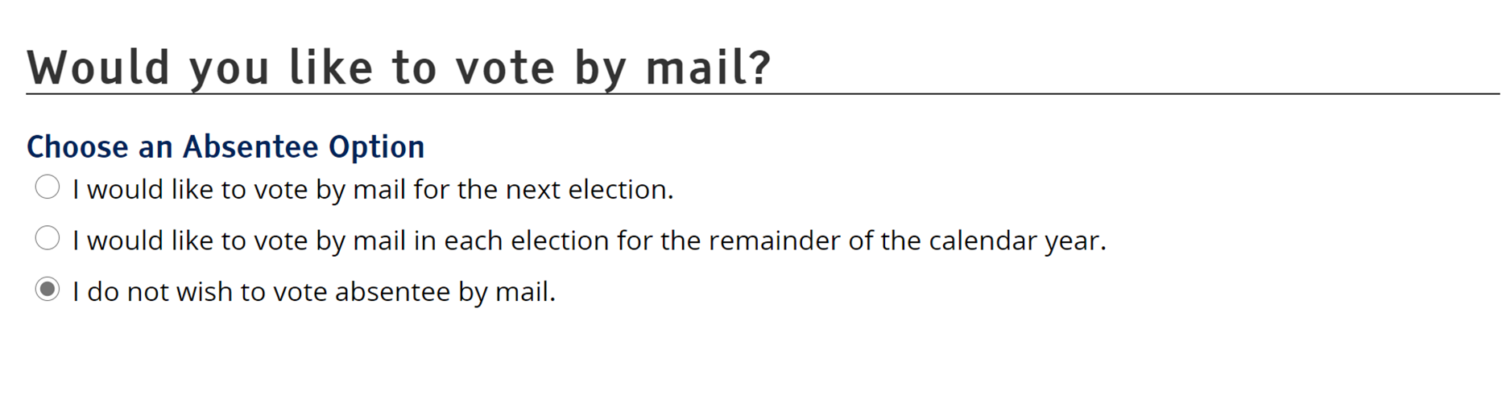
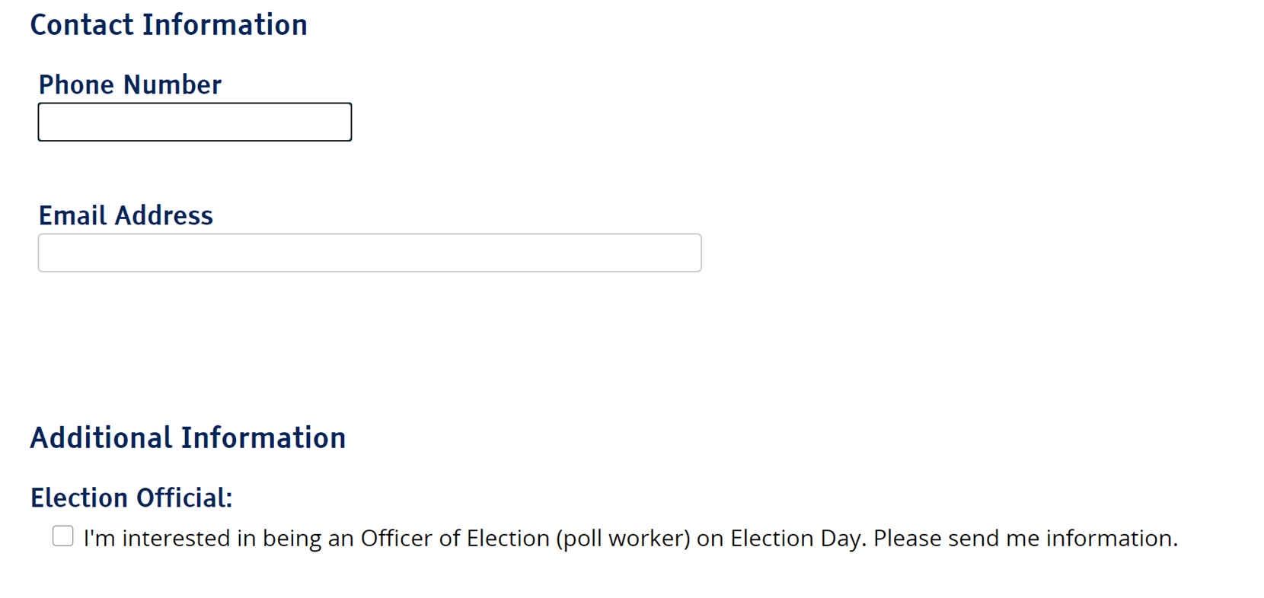

Notes:
OLD SCREEN Under the question, Would you like to vote by mail? the directions ask you to choose an absentee option. This means you need to decide if you want to vote by mail or not. The choice of NOT voting by mail (absentee) is selected for you. This means that you want to vote in-person either on Election Day or during Early Voting. If you do want to vote by mail, click on one of the other circles.
Your phone number and email address are not required, but if you select these, the Office of Elections might be able to contact you if there is a question about your registration.
You can also volunteer to work as a Poll Worker on Election Day.

Slide 15
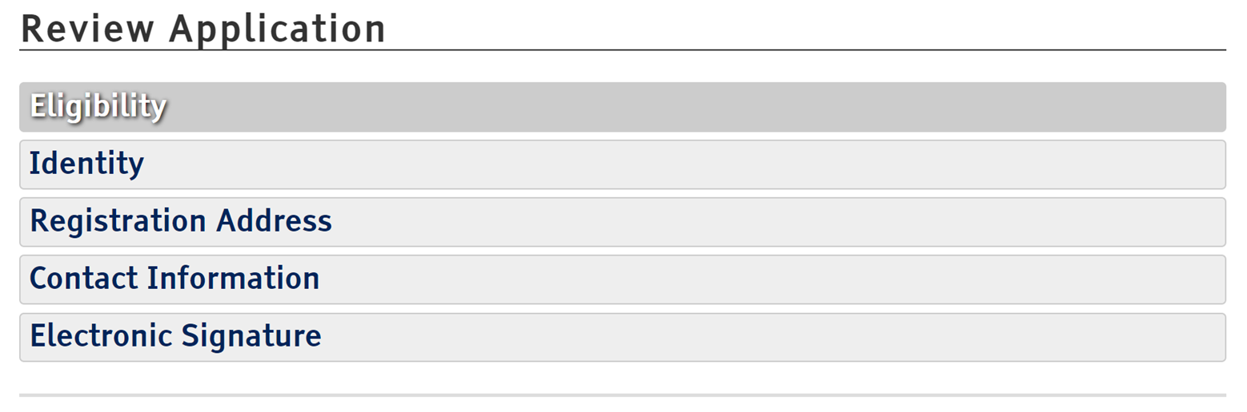

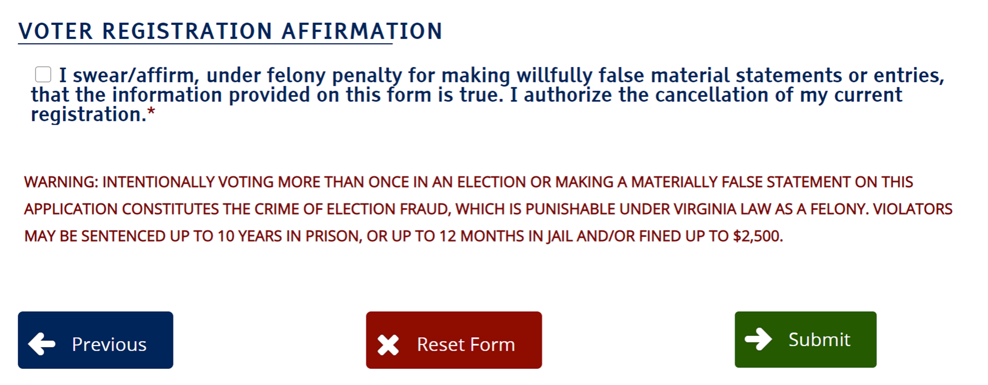
Notes:
OLD SCREEN? On this screen, you can click to reread the information that you provided.
You must click the box under: VOTER REGISTRATION AFFIRMATION. Here you are saying that the information you have provided is correct.
Then click the Submit button.

Slide 16
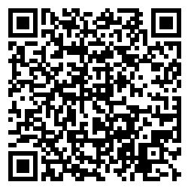
Register with a paper form.
    Go to https://www.elections.virginia.gov/media/formswarehouse/veris-voter-registration/applications/Voter-Registration-Application.pdf
    Scroll down and click on Download a pdf copy of the form.
    Print a paper copy.
    Or get a form from the Office of Elections or a library or email us at LWVarlingtonva@gmail.com
Notes:
If you don’t have a driver’s license or a learner’s permit or if you prefer to register with a paper form, click on the link. Then scroll down to see the choice, Download a pdf copy of the registration. This form is available in several languages. Select the form you want and print it. Then click to advance to the next slide of the PowerPoint.

Slide 17
Complete the Voter Registration Form
Use a blue or black pen only
Do not overlook Section 1
Check yes to Citizen.
Print name and address NEATLY
Full middle name or check NONE
Section 4 is for voters who may use a different mailing address
Use cursive ONLY for your signature
Notes:
You must use a blue (NOT turquoise) or black pen to complete the paper form. Use legible printing. It is important that the Board of Elections can read your handwriting. Only use cursive when you write your signature. Look at the highlighted sections on the slide. They are starred on the paper copy of the registration form. These sections must fully completed. Do not skip any part of these sections. If you have a middle name, you must write your whole middle name, not just your initial. If you do not have a middle name, be sure to check the box that says, “None.” Once completed, the form must be mailed to the Office of Elections. The address is on the slide. Click when you are ready to go to the next slide.

Slide 18
Complete the Voter Registration Form
For Arlington mail to:
Arlington Voter Registration & Elections
2100 Clarendon Blvd, Suite 320
Arlington, VA 22201
For other locations in Virginia see:
https://vote.elections.virginia.gov/voterinformation/publiccontactlookup
For Alexandria mail to:
Alexandria Voter Registration & Elections
132 N Royal Street #100
Alexandria, VA 22314

Slide 19
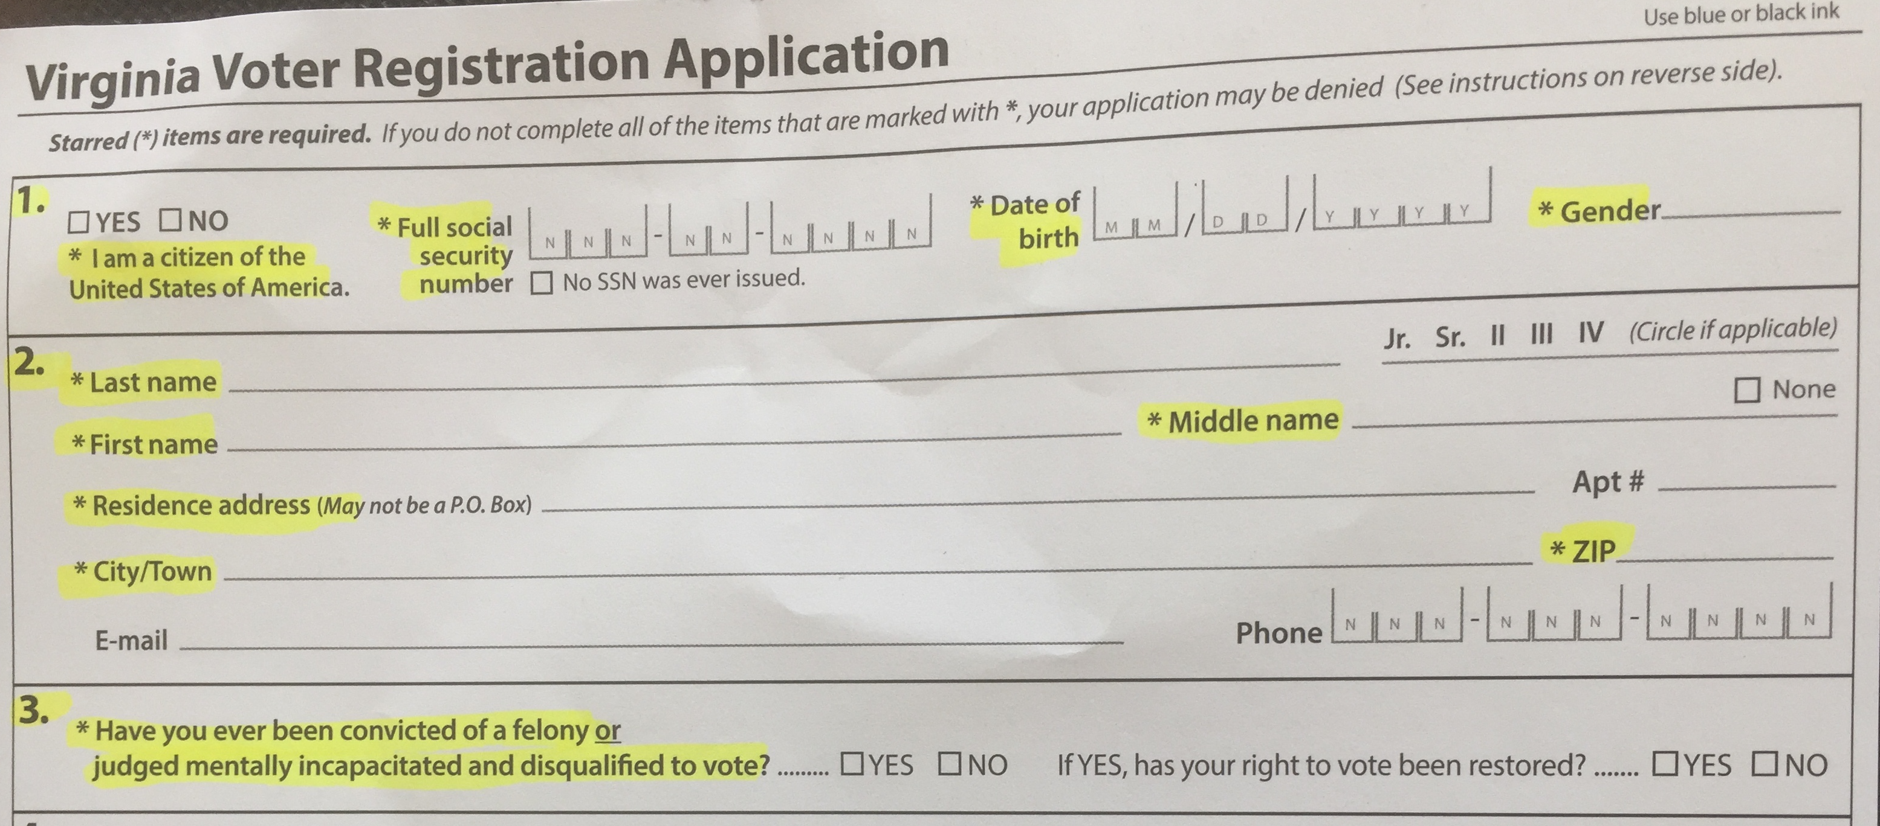
Voter Registration Form 1 – 3
Fill out all items with * , email and phone recommended

Slide 20
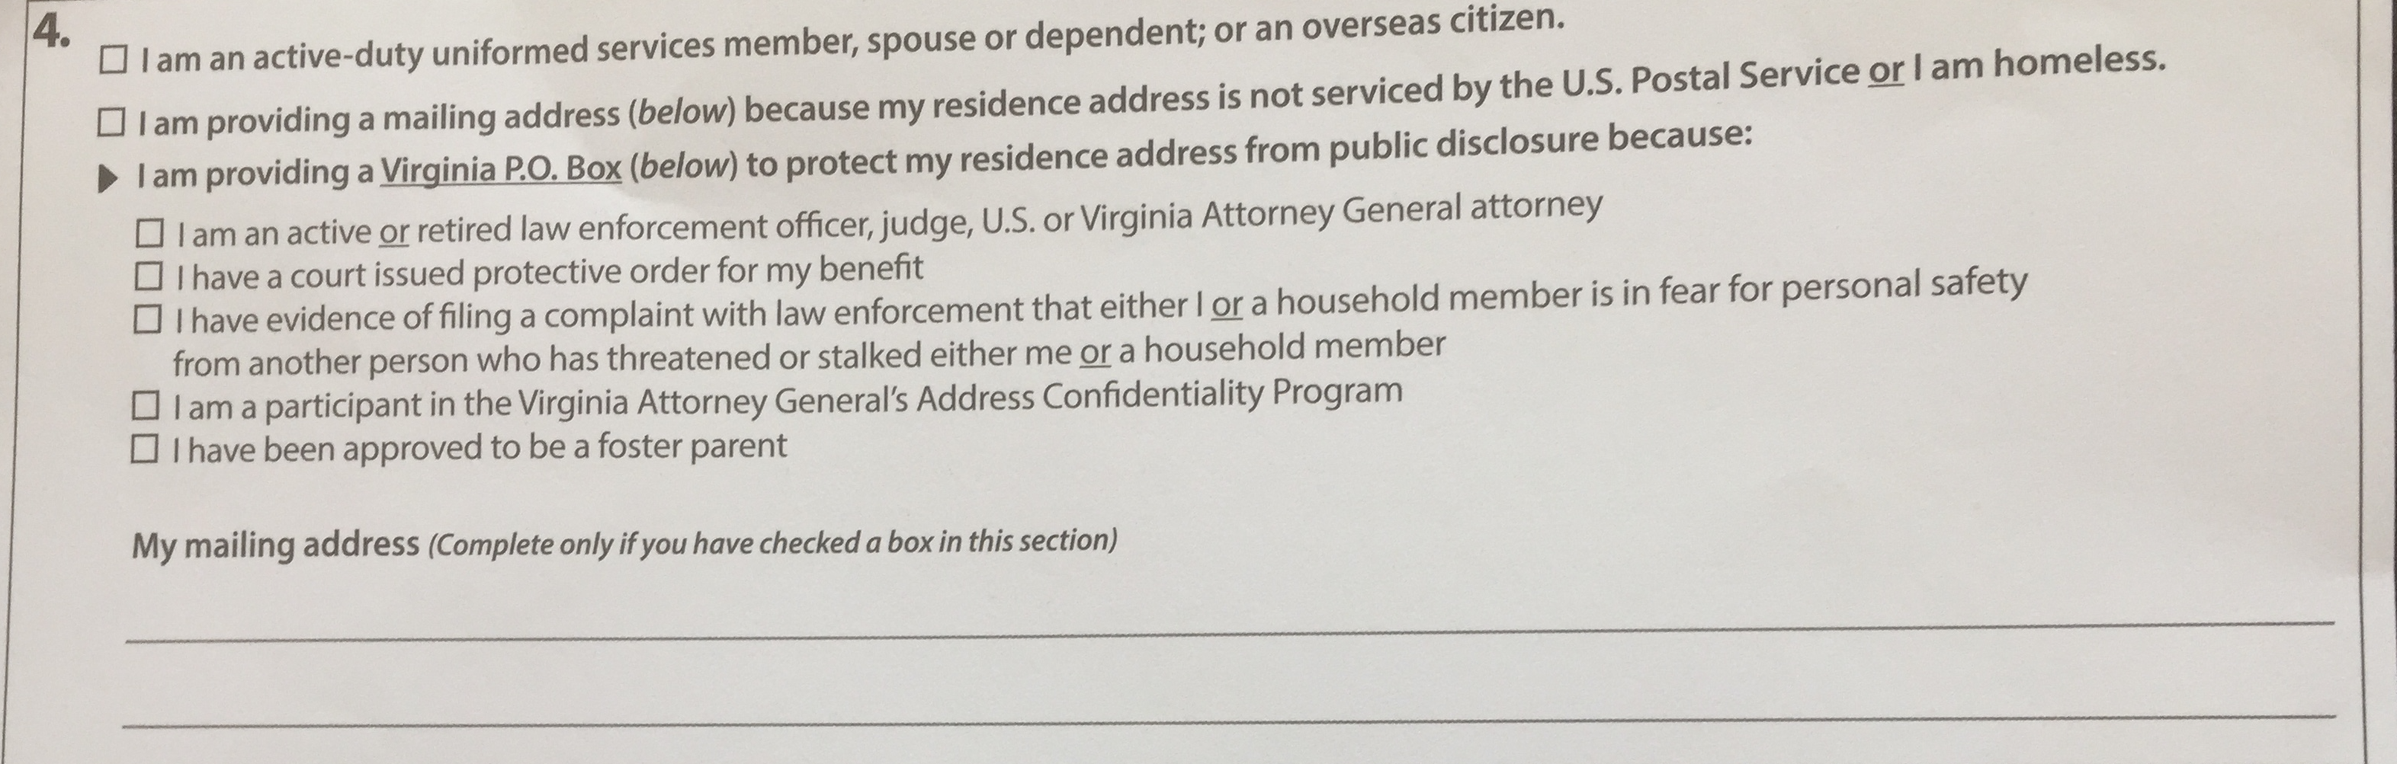
Voter Registration Form – 4
Does not apply to most people

Slide 21
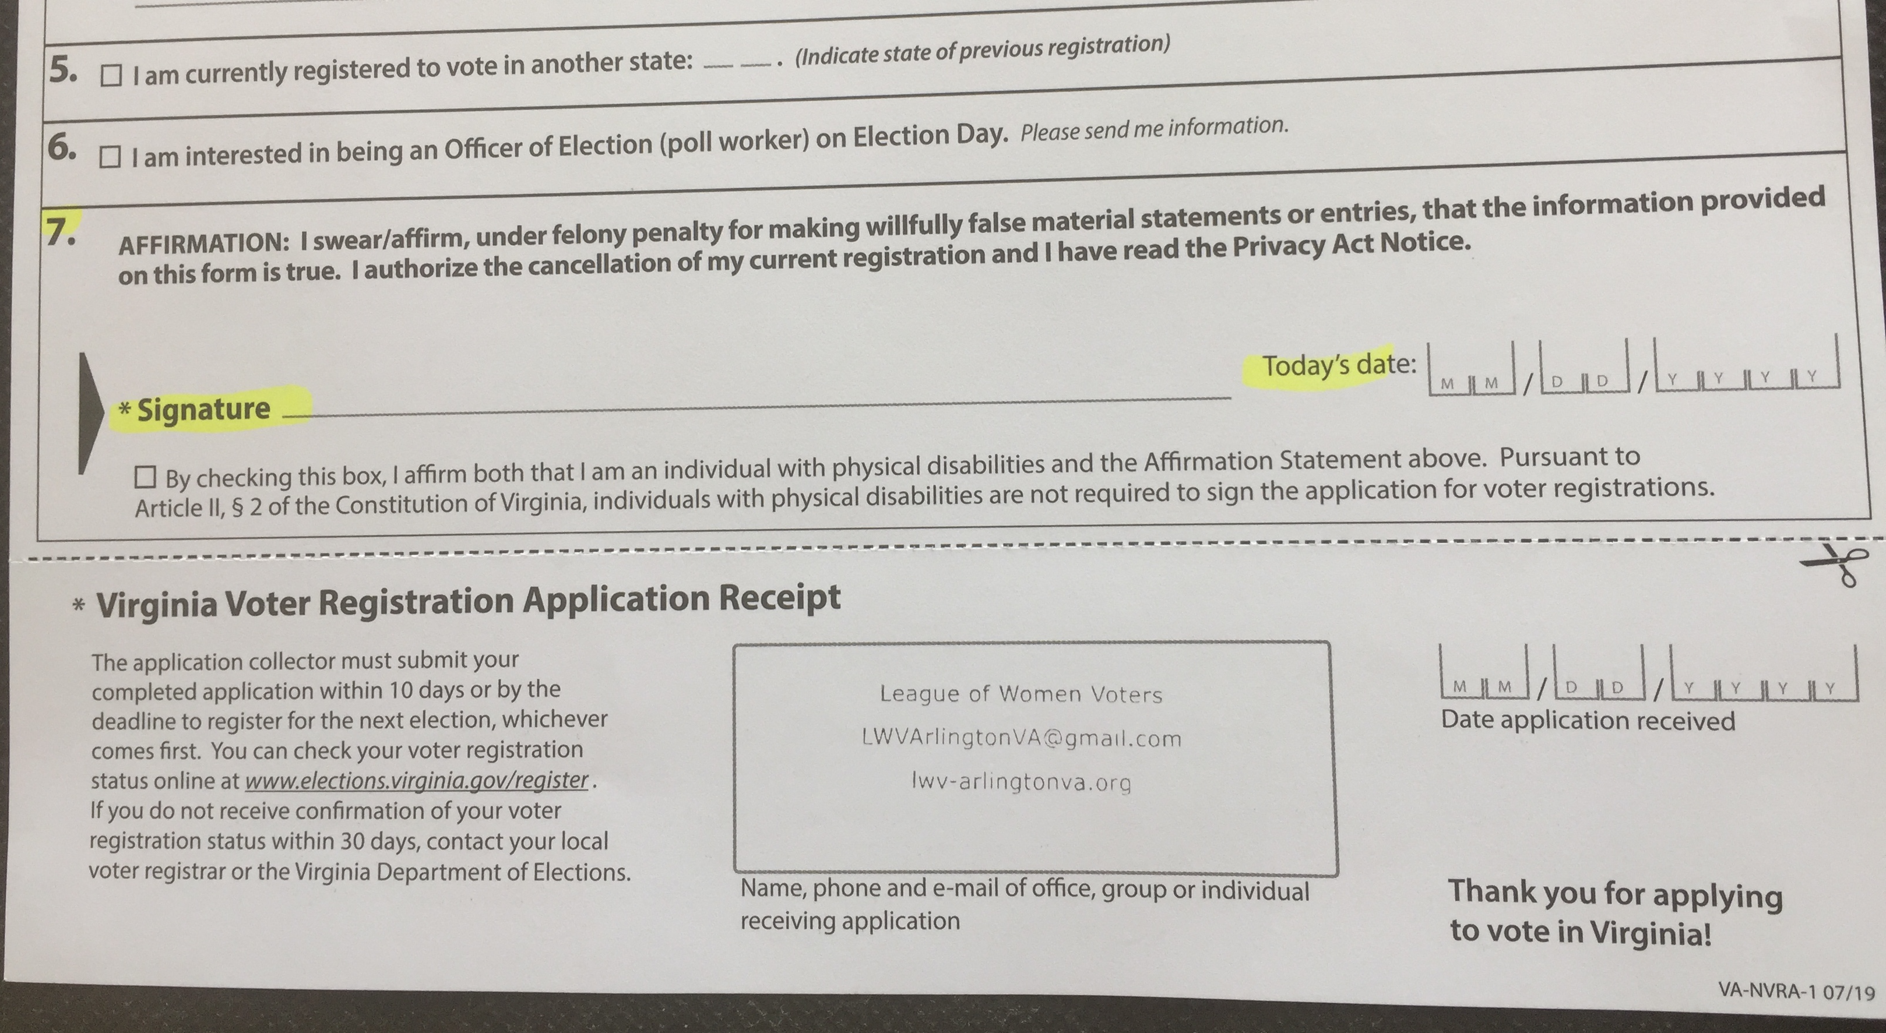
Voter Registration Form – 5 - 7

Slide 22
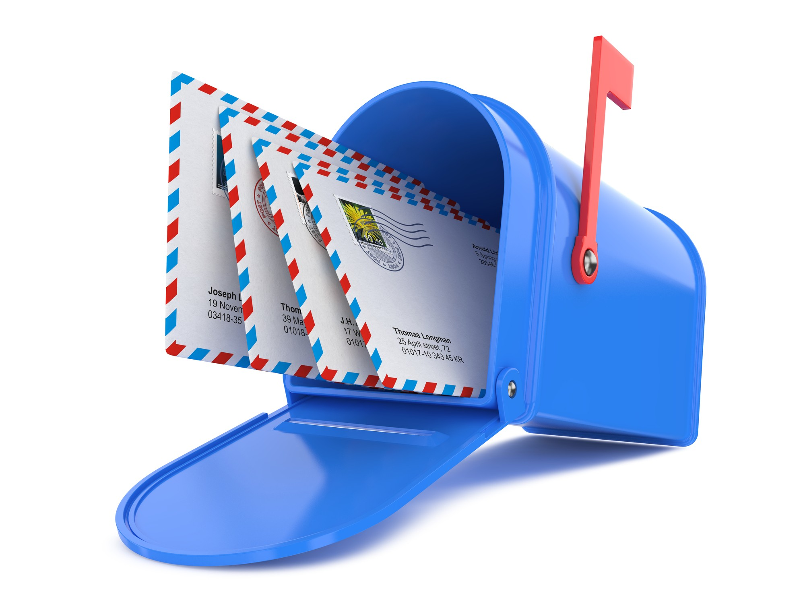
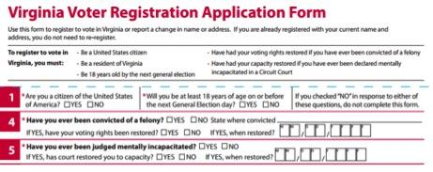
You've submitted your application.
Watch for mail!
Within 2 weeks you should receive:
A postcard, if successful
OR
Another application, if unsuccessful.
Notes:
Once you have completed the registration form, either online or by mail, you should receive notice in about a month from the Board of Elections. If your registration was successful, you will receive a post card that will tell you your polling (or voting) place. If your registration is not successful, you will receive a letter explaining the problem and a blank registration form to fill in and mail again.

Slide 23
Be Sure of Your Registration. Check Online.
Update your registration if you have….
  Moved to a new address (even if it is the apartment across the hall or a new dorm room)
  Changed your name
Check your registration to be sure…
  No later than Oct. 17, 2022
  If you have been registered for a while, make sure the information is correct

Slide 24
How Long Does Your Registration Last?
Once your registration is complete, you do not have to register again as long as you live in the same place or have kept your name.
Notes:
Register again if you have moved from one county or city to another, one home or apartment to another within the county. Also, if you have changed your name, change your registration.

Slide 25
First Time Vote by Mail Voter
Federal law requires individuals who register by mail, who are registering for the first time in the state or a new county or city to
  Vote in person or
  if they vote by mail, to present a copy of appropriate ID when voting for the first time in a federal election.
Voters who receive a notice about this special requirements need to include a copy of one of the following types of ID when returning a completed ballot:
  Current Valid Photo ID
  Current utility bill, bank statement, government check or paycheck that shows name and address;
  Another government document that shows name and address
If ballot returned without ID, It will be treated as a provisional ballot
To have ballot count, voter must provide ID to board of elections by deadline applicable to all voters
Notes:
Source: https://www.elections.virginia.gov/casting-a-ballot/absentee-voting/

Slide 26
General Election Information
November 8, 2022
The following offices are on the November 8 ballot*:
U.S. House of Representatives
County Board (1 Seat)
School Board (1 Seat)
The following bond issues are on the November 8 ballot*:
Metro and Transportation ($52,630,000)
Local Parks and Recreation ($22,460,000)
Community Infrastructure ($53,300,000)
Arlington Public Schools ($165,010,000)
Stormwater ($39,760,000)
Utilities (177,360,000)

Slide 27
Dates to Remember
Early Voting: Begins Friday, September 23*
Deadline to Register to Vote is Monday, October 17
https:bit.ly//VoteArlington
Deadline to Apply for an Absentee Ballot—October 28 by 5 pm
https://bit.ly/VoteArlington

Slide 28
Early Voting
Courthouse Plaza
2100 Clarendon Boulevard, Suite 311
September 23 November 4
Mon - Fri......8am - 5pm
Saturday, October 29 and Saturday, November 5, 9 am-5 pm
Sunday, October 30, 11 am-3 pm
Tuesday, Wednesday, Thursday, October 25-27; November 1-3, 8 am-7 pm
Madison Community Center
3829 Stafford Street
Saturday, October 29 and Saturday, November 5, 9 am-5 pm
Sunday, October 30, 11 am-3 pm
Tuesday, Wednesday, Thursday, October 25-27; November 1-3, 2 pm-7 pm
Walter Reed Community Center
2909 – 16th Street South
Saturday, October 29 and Saturday, November 5, 9 am-5 pm
Sunday, October 30, 11 am-3 pm
Tuesday, Wednesday, Thursday, October 25-27; November 1-3, 2 pm-7 pm

Slide 29
Drop Boxes
There are 9 drop boxes in Arlington
https://vote.arlington.us/Vote-by-mail/ballot -drop-off

Slide 30
Candidate Forums
Arlington School and County Board – Virtual
Oct 2 – 4 – 5:30 PM - https://LWVARLALEXCANDIDATE.eventbrite.com
8th Congressional District – Virtual
Oct 13 – 7:00 – 8:30 PM - https://LWV8thdistrictforum.eventbrite.com
Disability Voting Rights Event
Oct 15 – 1:00 – 3:00 PM Arlington Central Library
https://DisabilityVotingRights.eventbrite.com

Slide 31
If You Have Questions….
Alexandria Voter Registration & Elections
https://www.alexandriava.gov/Elections
132 N Royal Street, Suite 100
Alexandria, VA 22314
703-746-4050
angela.turner@alexandriava.gov
Arlington Voter Registration & Elections
https://vote.arlingtonva.us/
2100 Clarendon Blvd, Suite 320
Arlington, VA 22201
703-228-3456
voters@arlingtonva.us

Slide 32
If You Have Questions….
Virginia Department of Elections (ELECT)
http://elections.virginia.gov/
Washington Building, First Floor 1100 Bank Street Richmond 23219-3642
804-864-8901
info@elections.virginia.gov

Slide 33
Maryland Information
To register in Maryland you must:
be a U.S. citizen
be a Maryland resident
be at least 16 years old, but at least 18 years old to vote
not be under guardianship for mental disability
not have been convicted of buying or selling votes
not have been convicted of a felony, or if you have, you have completed serving a court-ordered sentence of imprisonment, including any term of parole or probation for the conviction.
The deadline to register for the November election is Oct 13, 2020.
To register or vote by mail go to:
https://voterservices.elections.maryland.gov/OnlineVoterRegistration/InstructionsStep1

Slide 34
District of Columbia Information
To vote in the District of Columbia you must:
be a citizen of the United States
be a be a resident of the District of Columbia
maintain residency in the District of Columbia for at least 30 days prior to the election in which you intend to vote
not claim voting residence or the right to vote in another U.S. state or territory
be at least 17 years old
not be in jail for a felony conviction and not have been found by a court to be legally incompetent to vote
DC has same day registration at the polls.
For more information
https://www.dcboe.org/FAQS/Voter-Registration

