Slide 1
Lacey Woods Park Renovations
Bluemont Civic Association
September 25, 2024

Slide 2
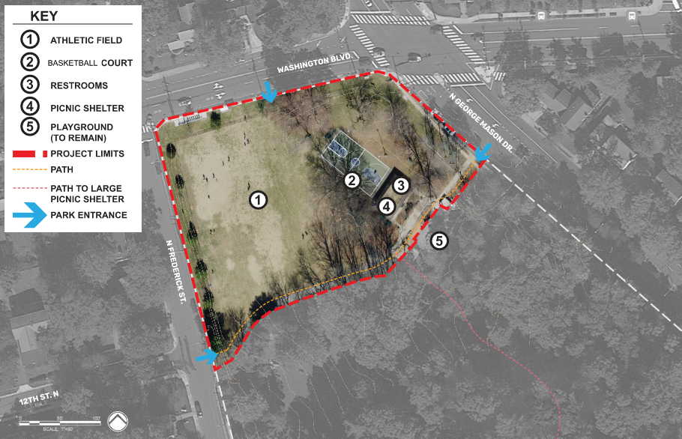
Project goals
Project Goals:
Renovate restrooms, picnic shelter, basketball court and lighting and athletic field
Add site furnishings
Improve site circulation
ADA improvements
Improve drainage
Funding:
FY2020 Parks Maintenance Capital

Slide 3
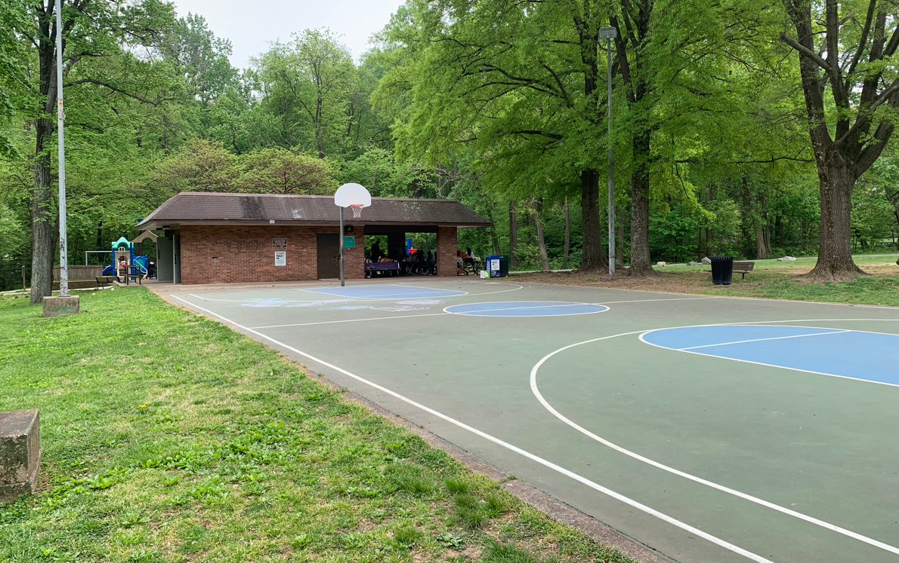
Existing conditions

Slide 4
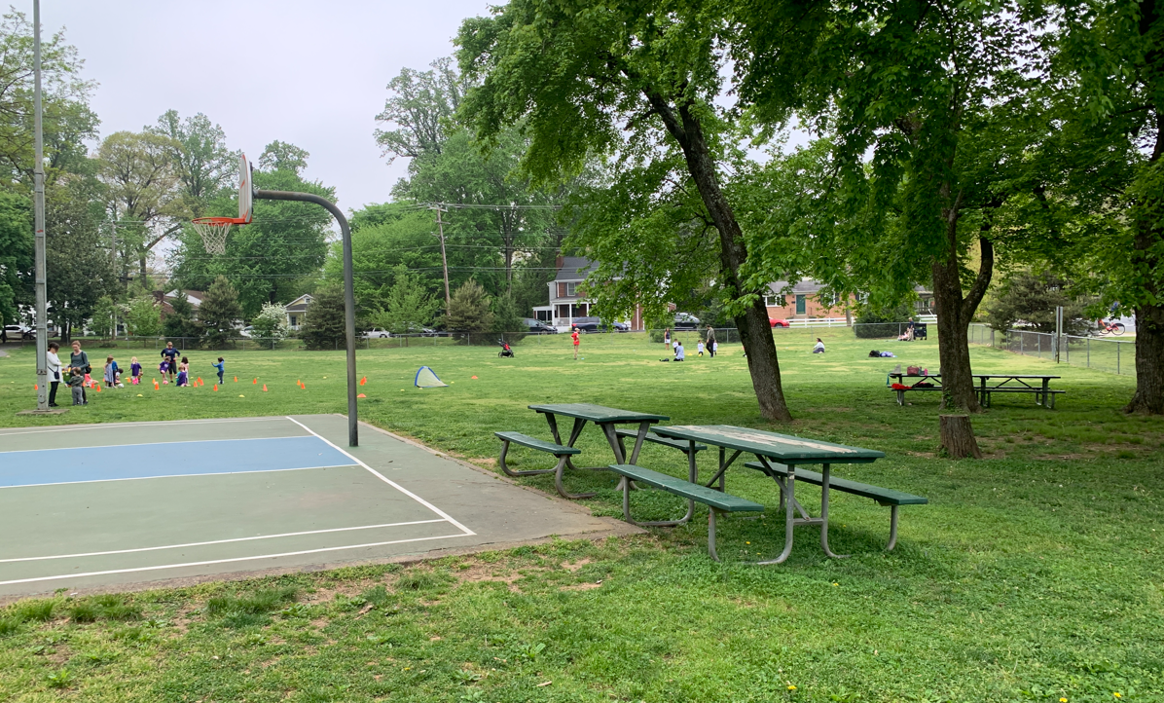
Existing conditions

Slide 5
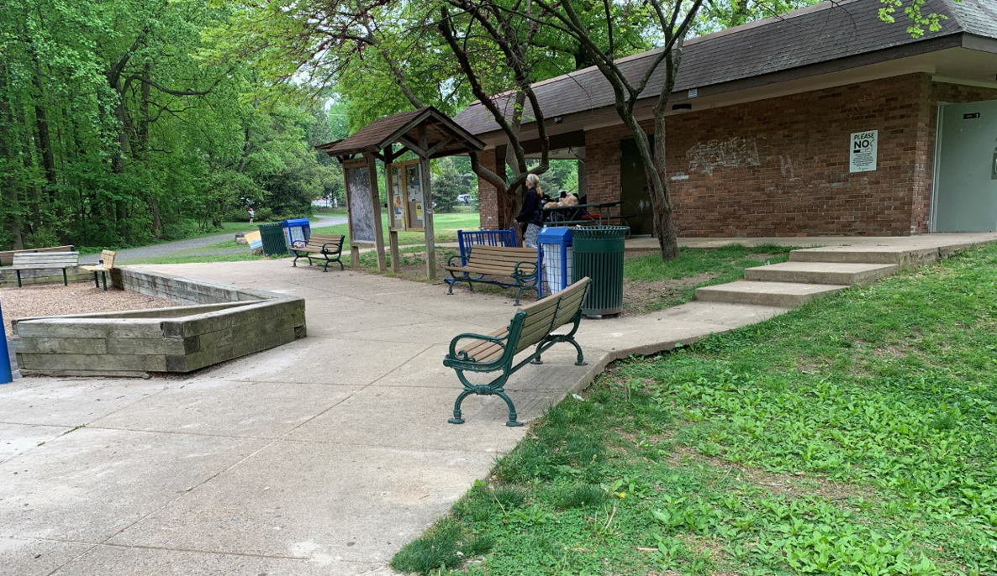
Existing conditions

Slide 6
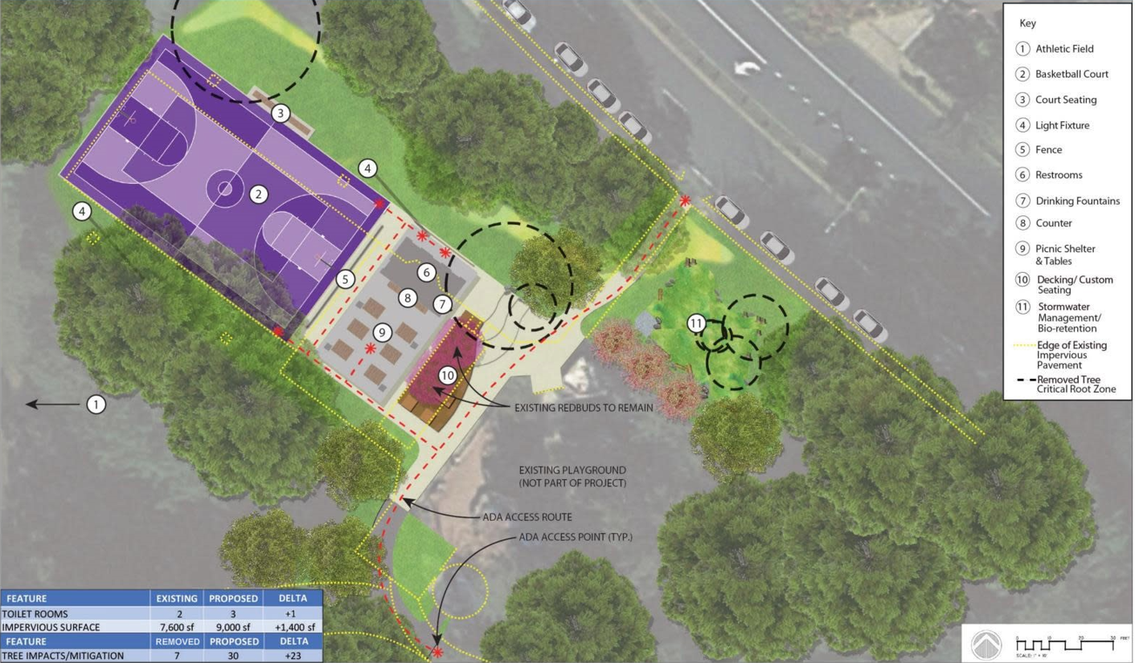
Final conceptual plan

Slide 7
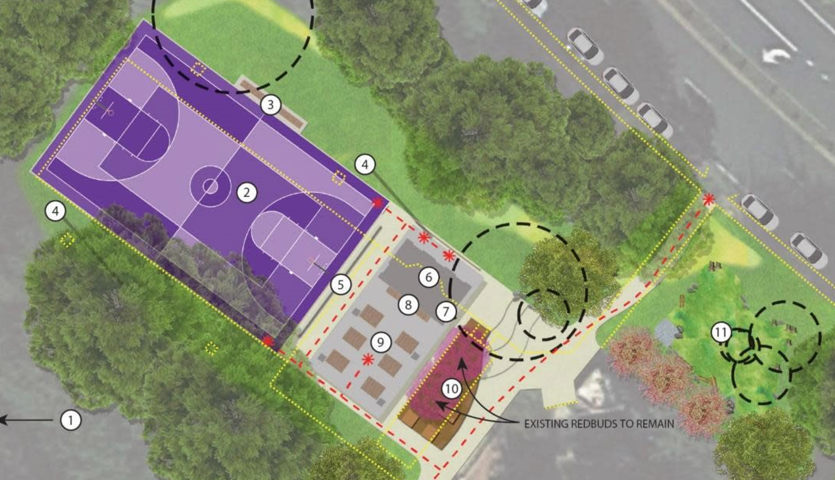
Final conceptual plan

Slide 8
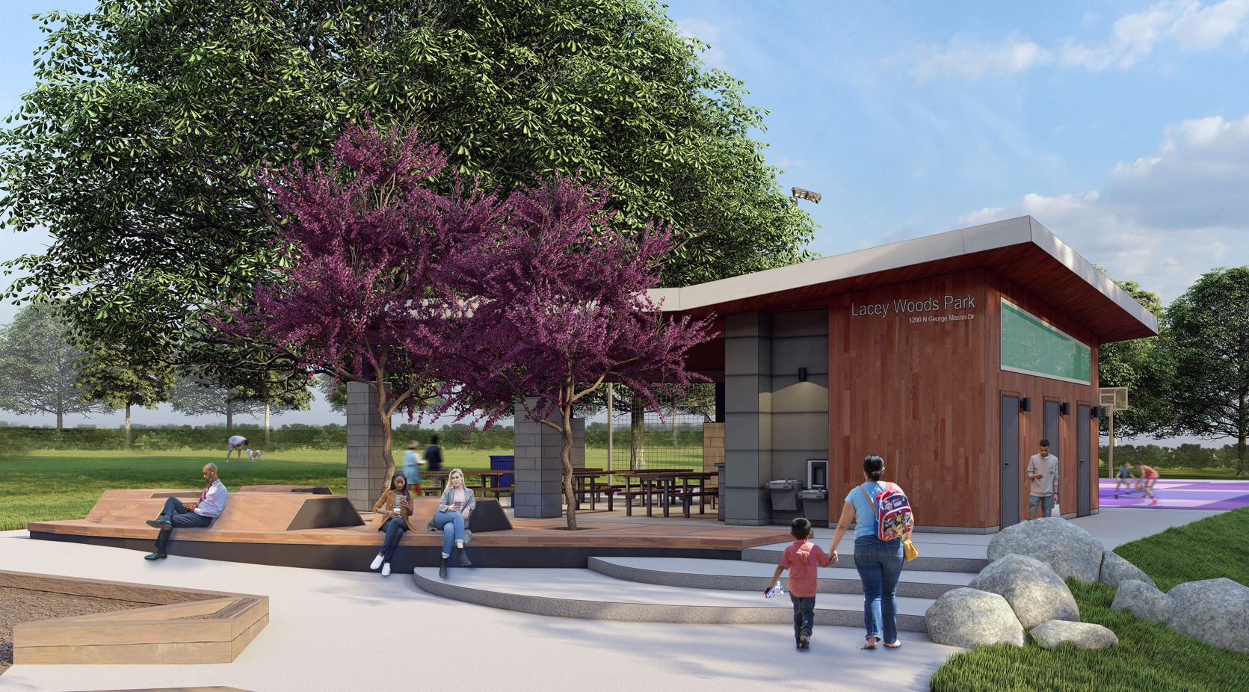
View a

Slide 9
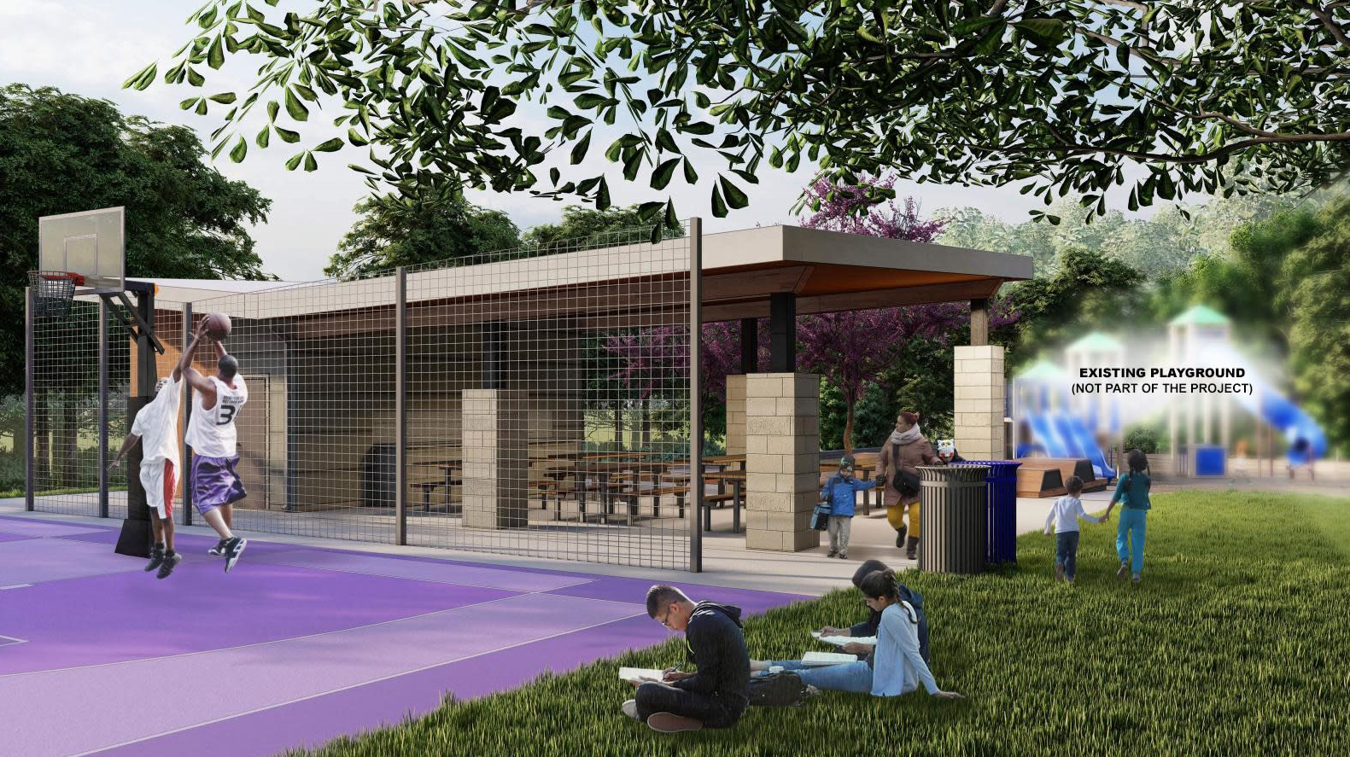
View B

Slide 10
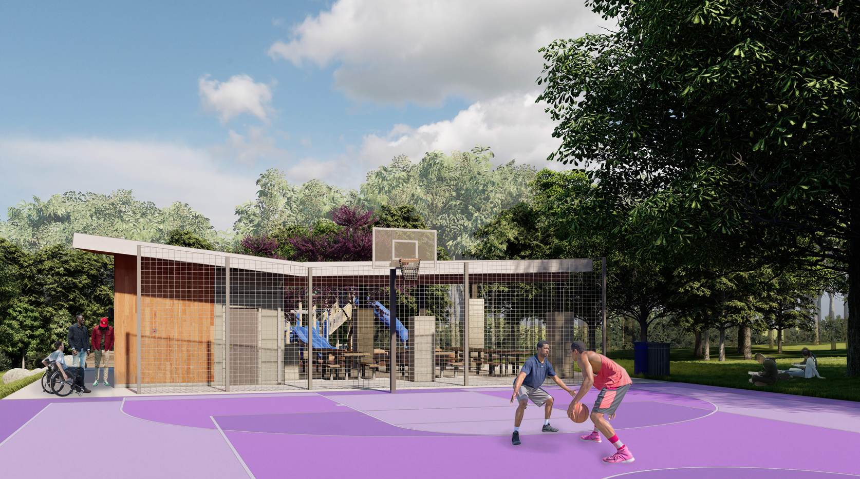
View C

Slide 11
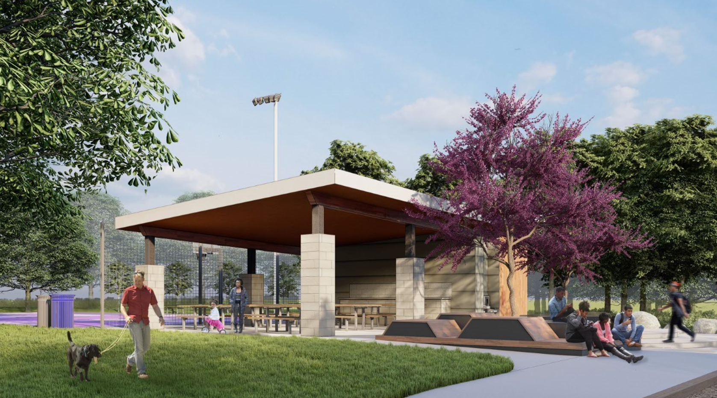
View D

Slide 12
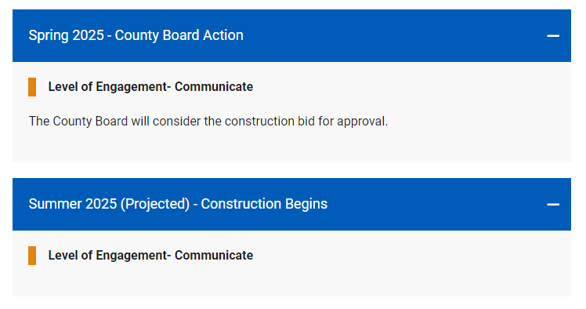
Next steps

Slide 13
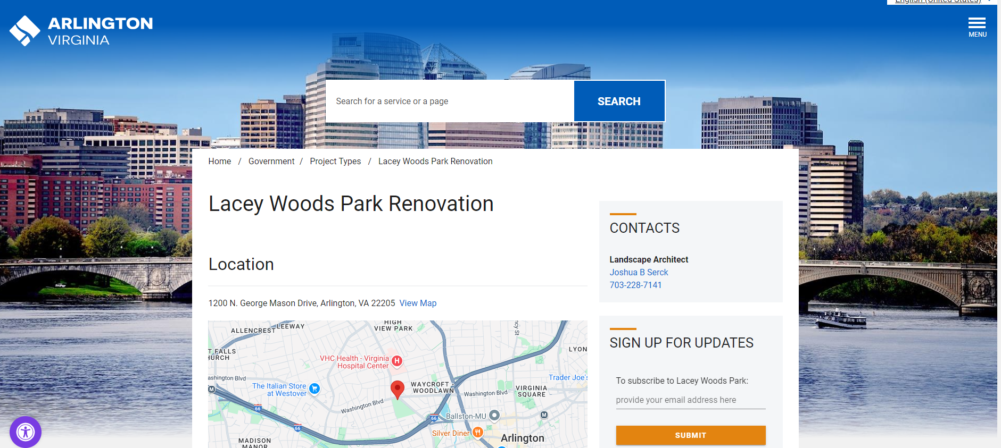
Stay connected
https://www.arlingtonva.us/Government/Projects/Project-Types/Uncategorised/Lacey-Woods-Park-Renovation.com

