Slide 1
About Emergency Management

Slide 2
Today’s Presentation
What do emergency managers do?
DPSCEM overview
Review trends in emergency management (EM)
Review challenges in EM
Discuss how the field of EM is anticipating and addressing those challenges
Questions + comments

Slide 3
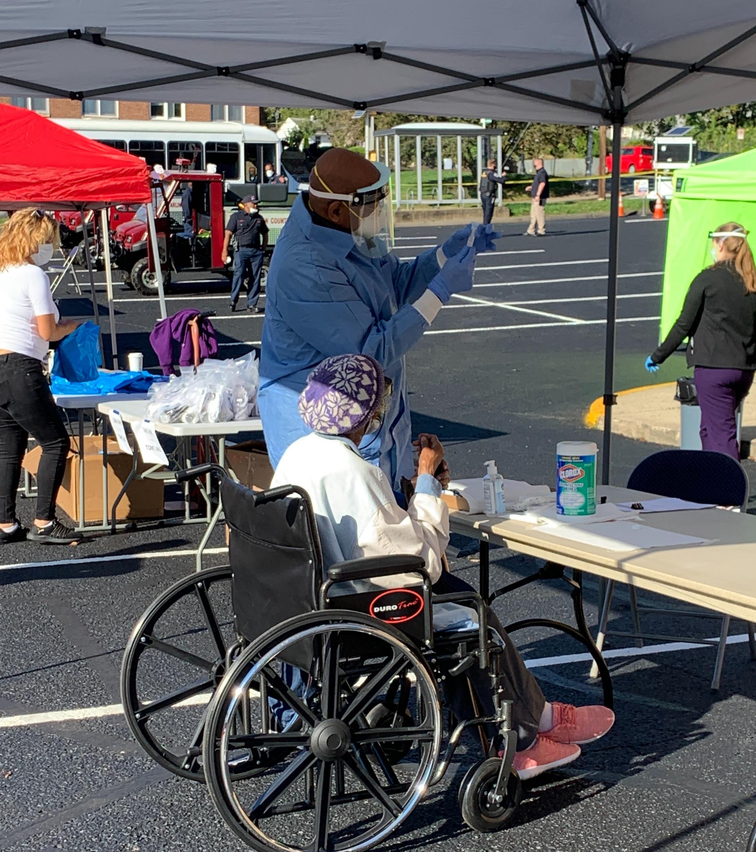
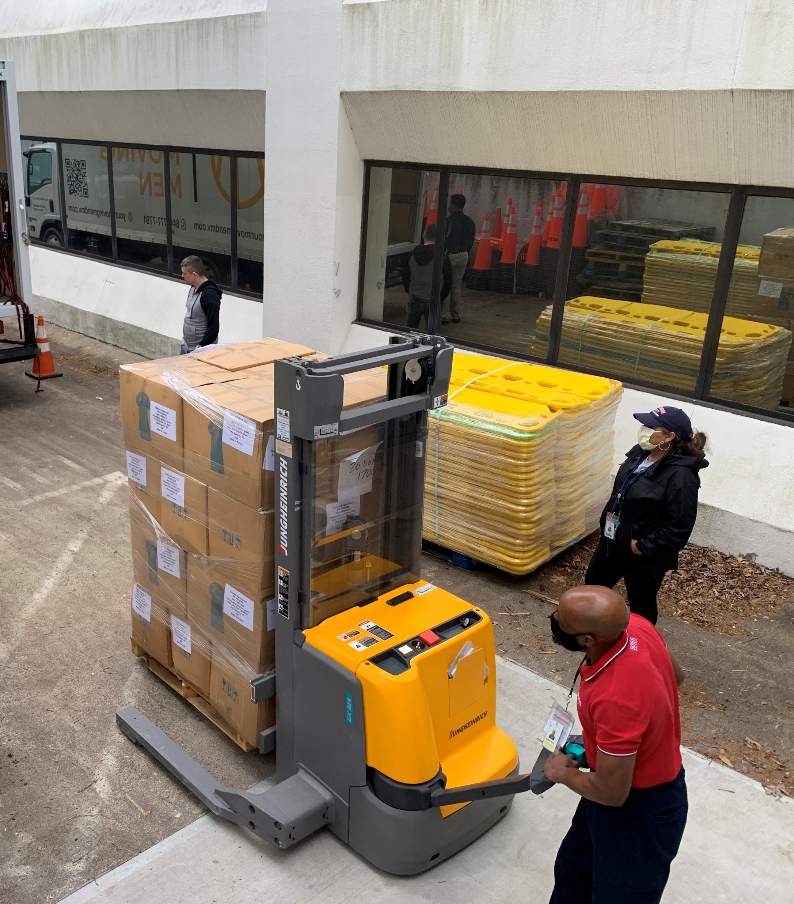
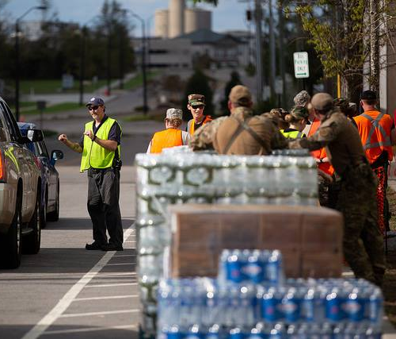
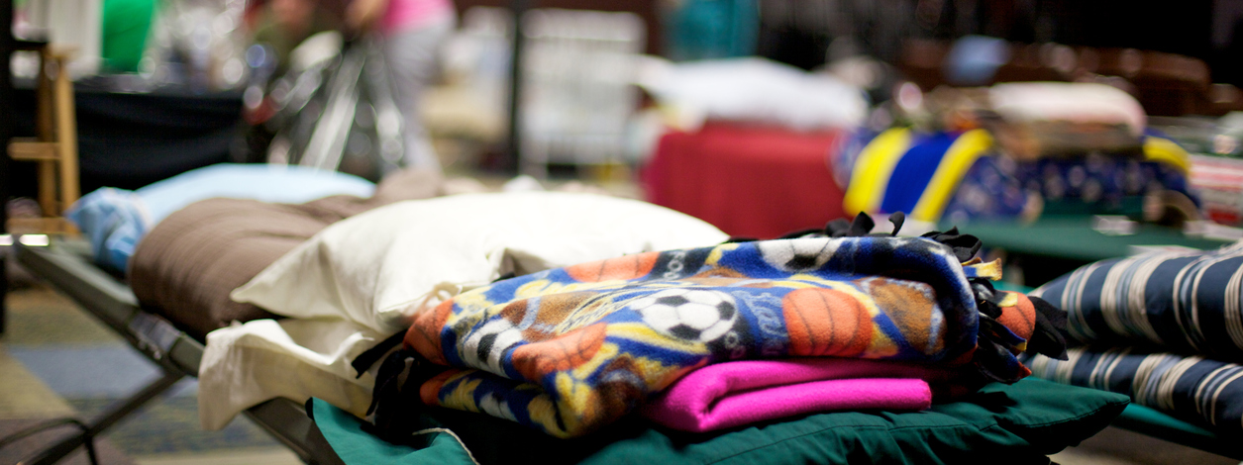
What Do Emergency Managers Do?
Notes:
Emergency Managers are involved when an incident is large, has multiple parts, or requires additional resources other than first responders (Fire, EMT, PD).
Emergency managers are involved not only with response, but also preparedness, mitigation and making sure a disaster does not have as drastic of an impact as it could have, and rebuilding after a disaster.

Slide 4
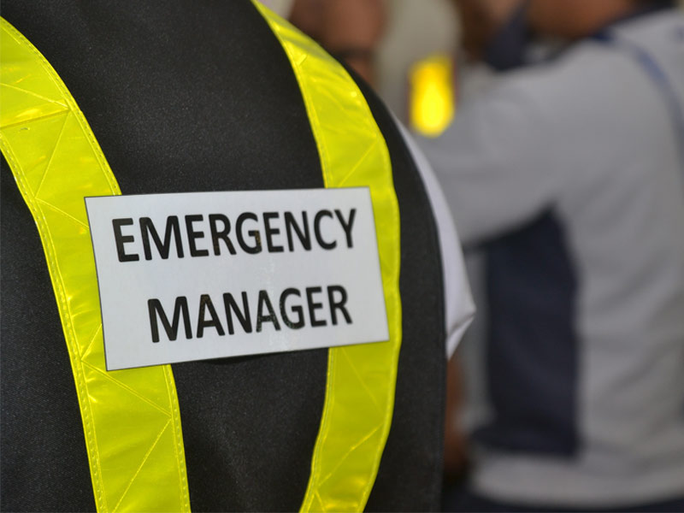
Gather the facts
Connect people and organizations
Turn chaos into organization
Manage info, resources, and consequences
Keep everyone in constant communication
Restore order a sense of order as quickly as possible
Notes:
Who’s in charge? What’s happening? Is it getting worse or better? And what needs to be done.
Connect people and organizations
Turn Chaos into Organization: take decisions made by leaders and decision-makers and translate them for those on site—the boots-on-the-ground folks—PD, FD, EMT, etc.
Manage Info, resources, and consequences
Keep everyone in constant communication!
In short - We are the Chaos Coordinators!

Slide 5
Department of Public Safety Communications & Emergency Management
Notes:
DPSCEM-or the Department of Public Safety Communications and Emergency Management—has a mission to coordinate emergency preparedness, response, and recovery capabilities, resources, and outreach for the Arlington community.
In simple terms, this means that our team is responsible for not only responding to emergencies and communicating to the public what’s happening but also coordinating the response and recovery. This means working with other departments within our County as well as state and federal partners to make sure resources and services are available to our community during and after an emergency, and of course, making sure the community is prepared in the case of an emergency. As I mentioned earlier, we’re the chaos coordinators!
Our office is split into three divisions: the Emergency Communications Center (ECC), Emergency Management, and Integrated Programs

Slide 6
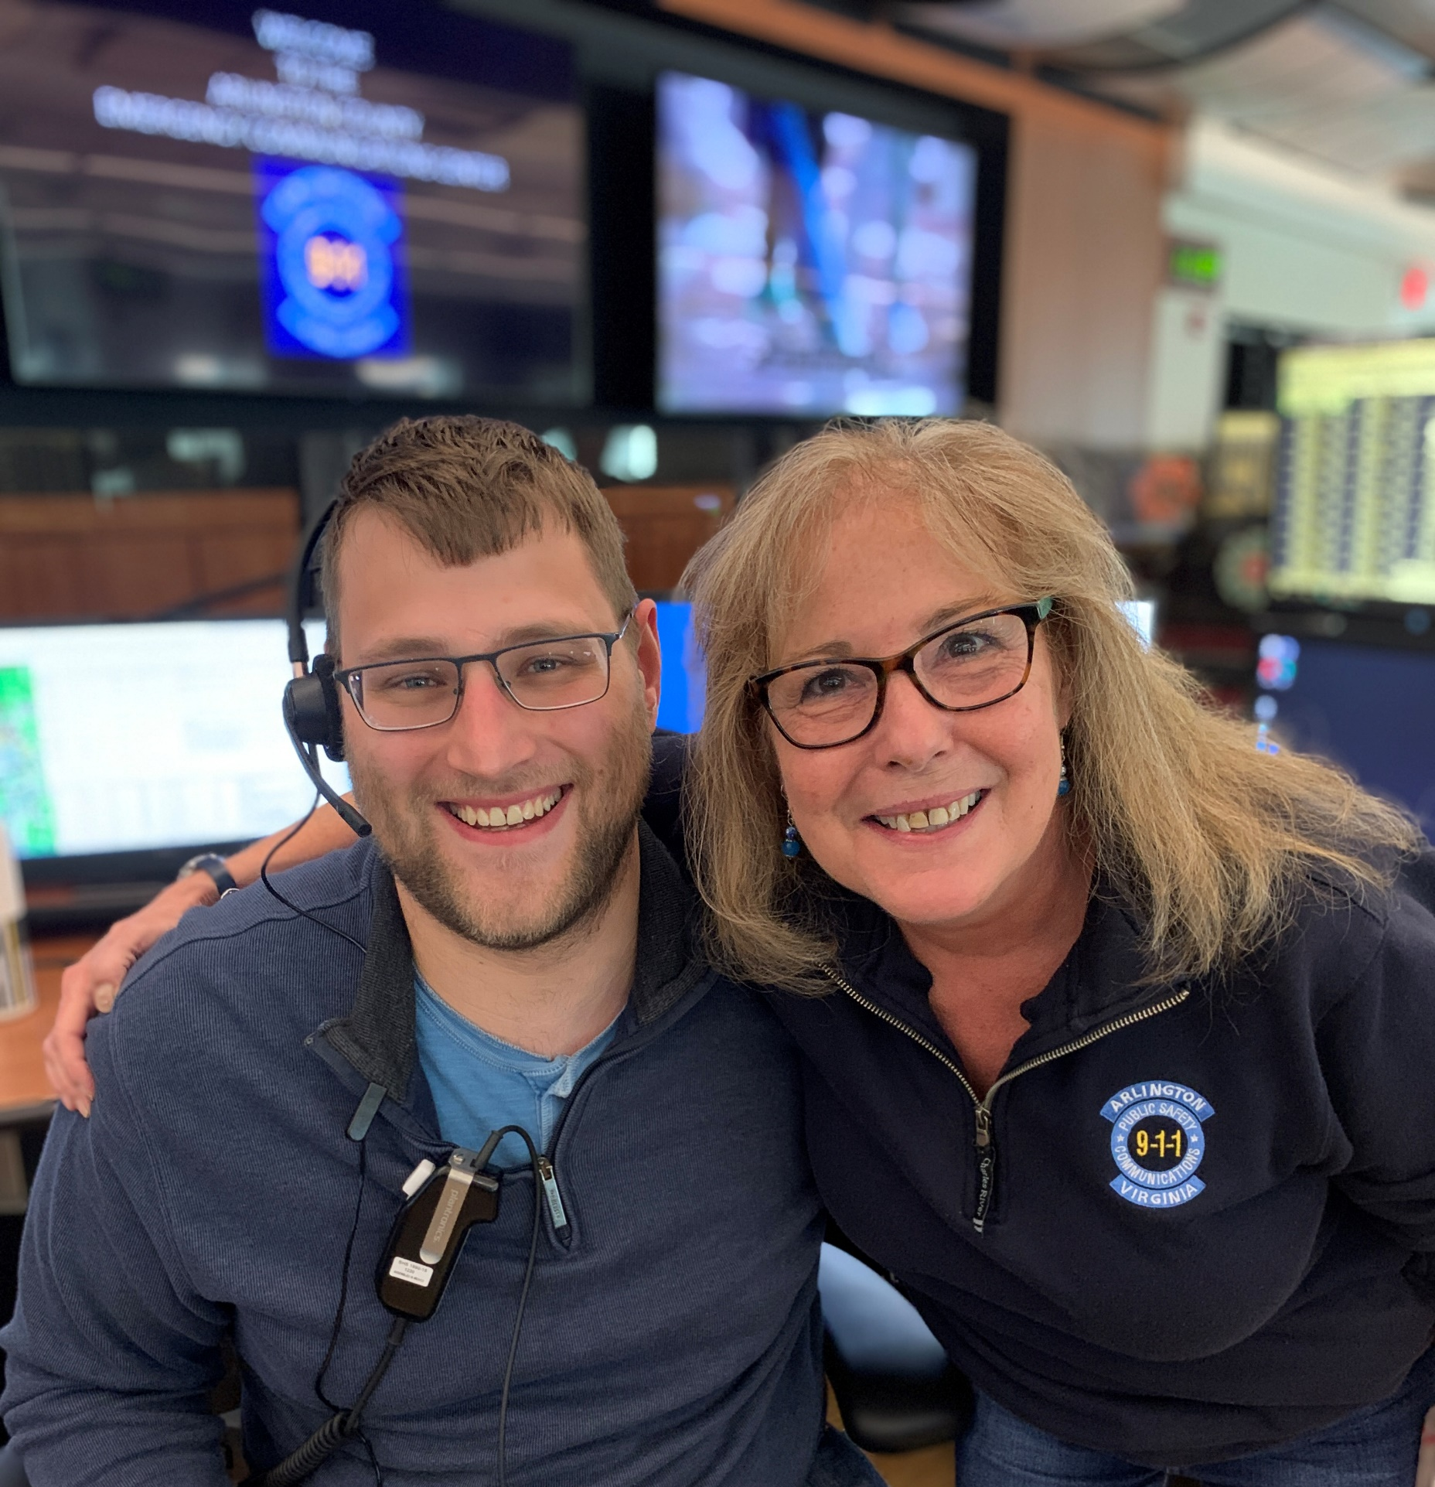
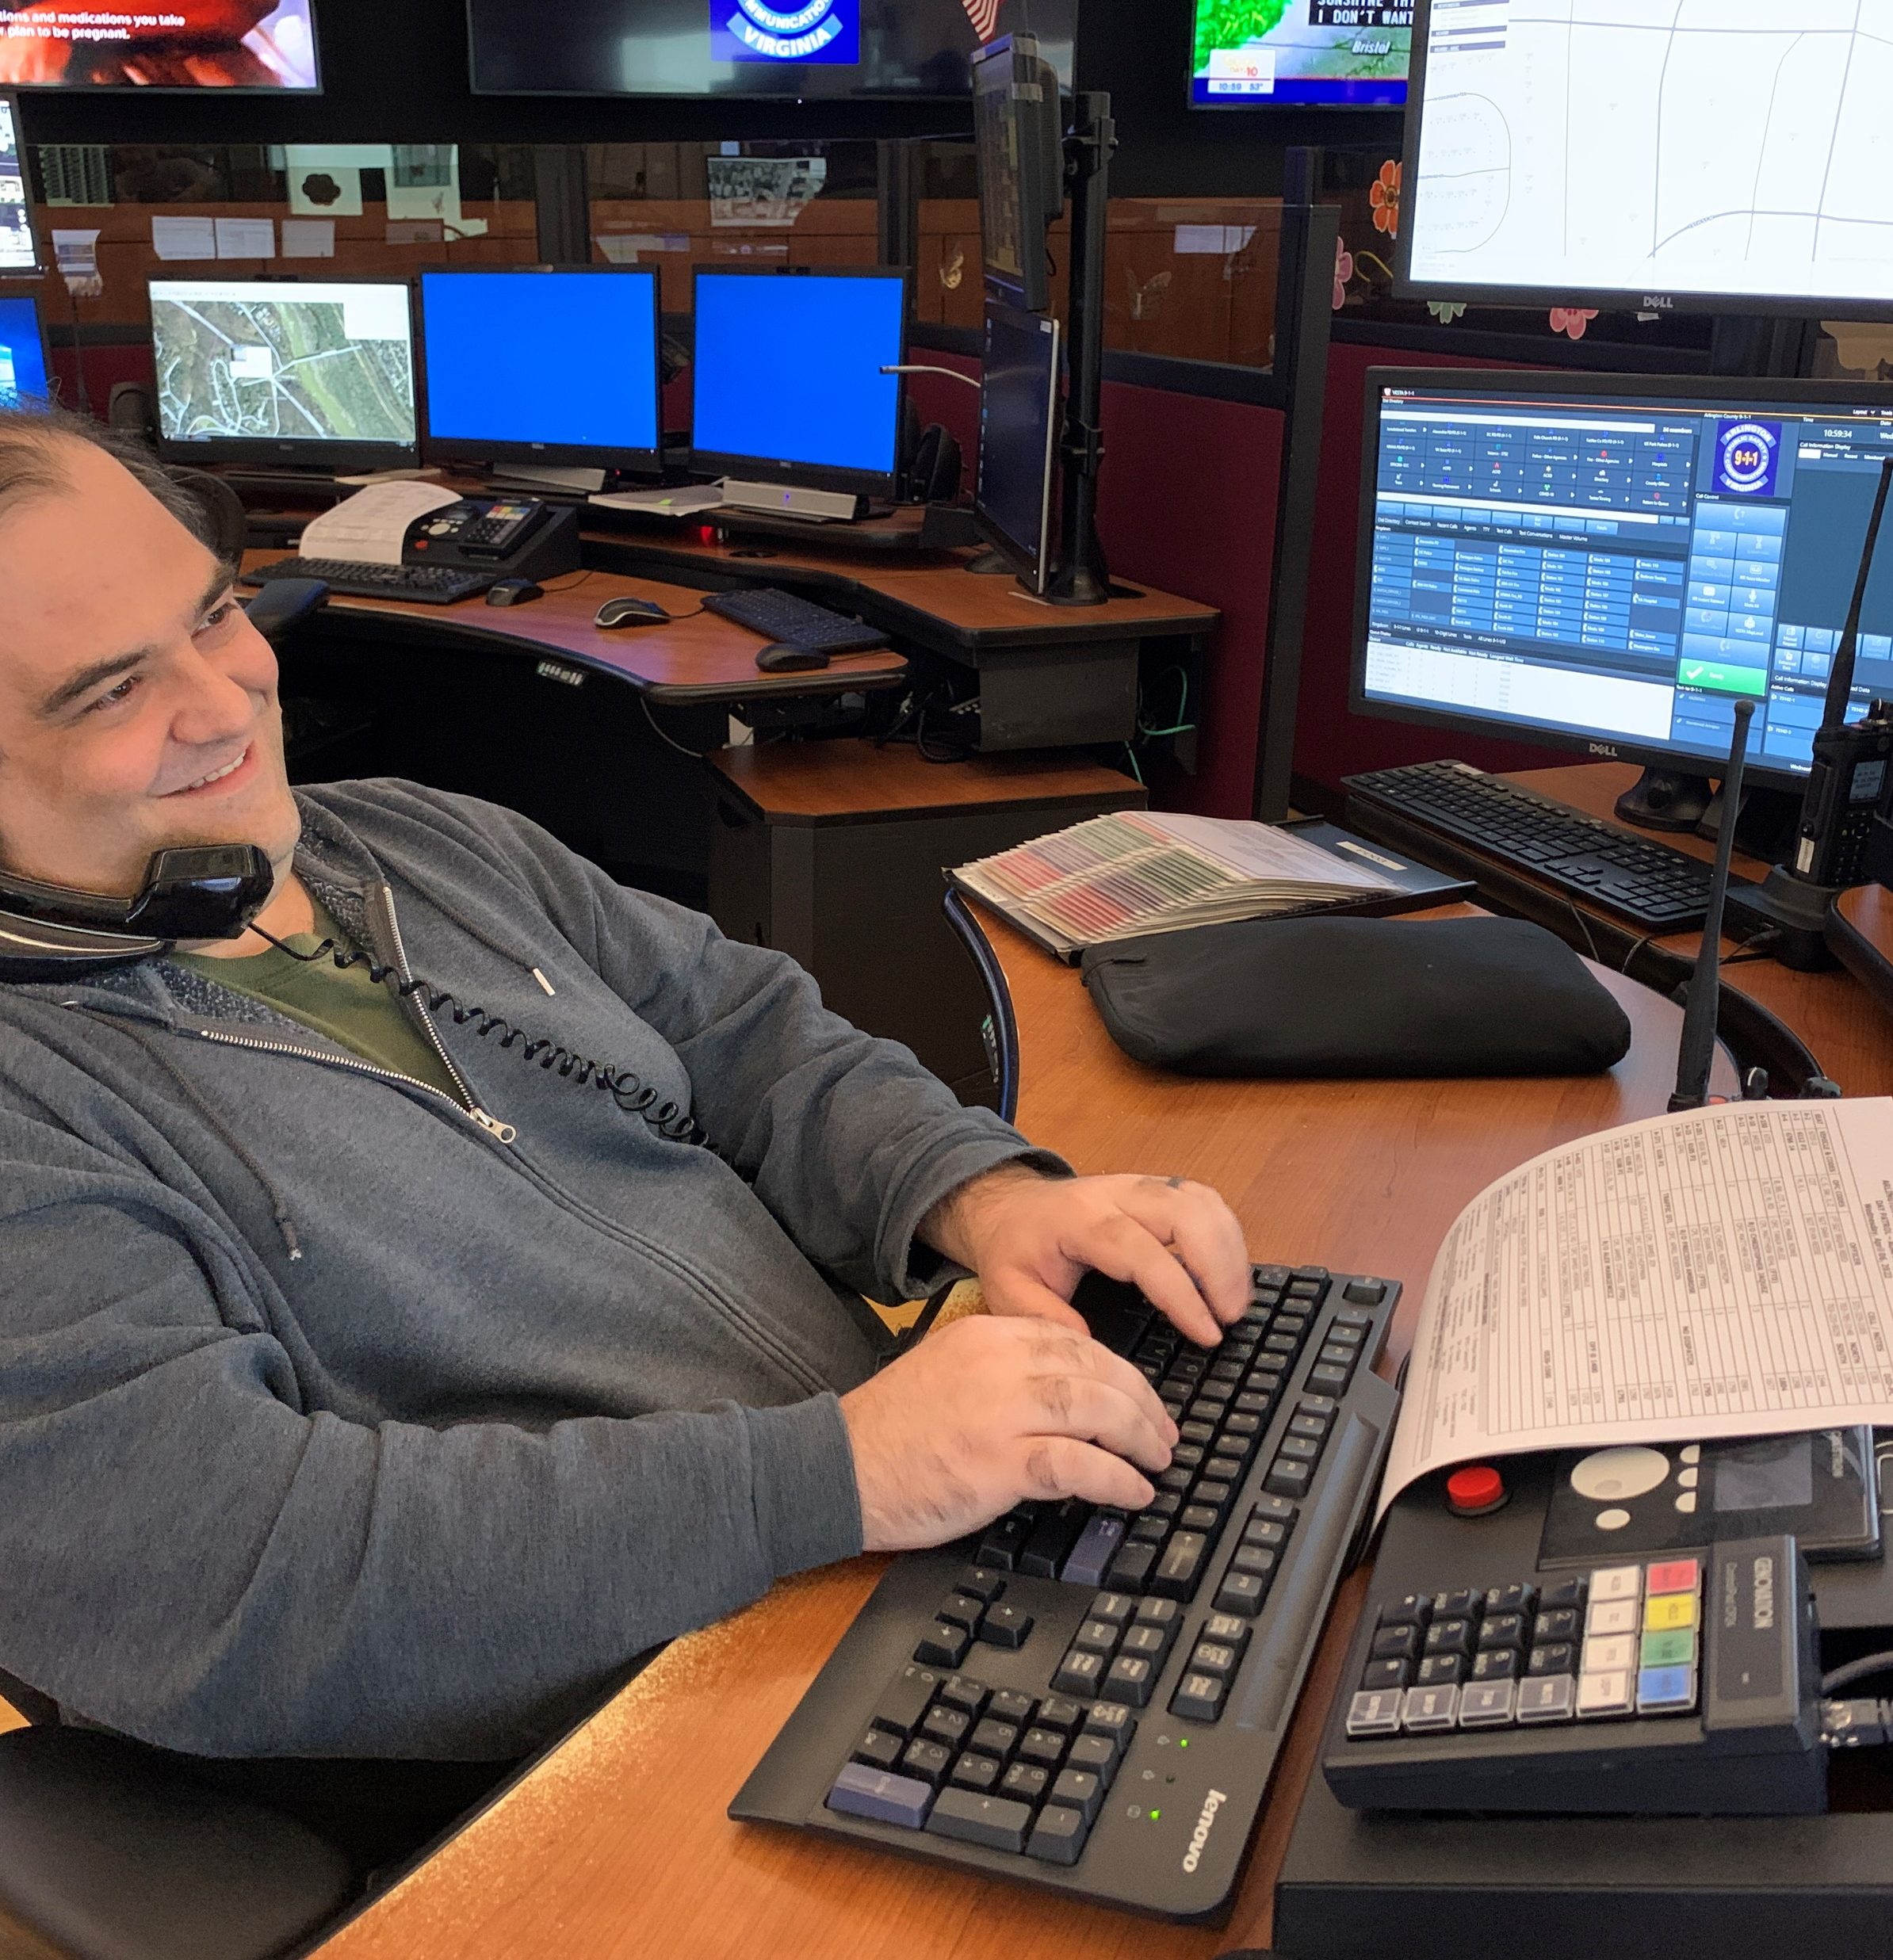
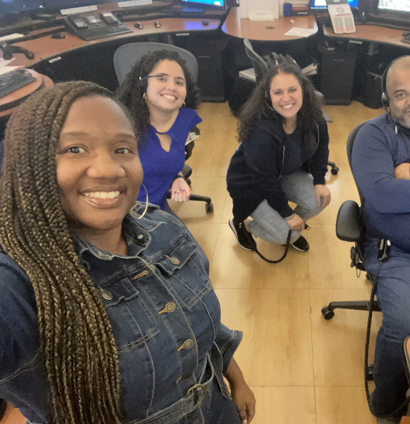
Emergency Communications Center (ECC)
Notes:
The first division is the Emergency Communications Center, or ECC, which takes all the 9-1-1 calls, and dispatches calls accordingly.
For context, in the past year our ECC answered about 250,000 calls (April 2022-April 2023).

Slide 7
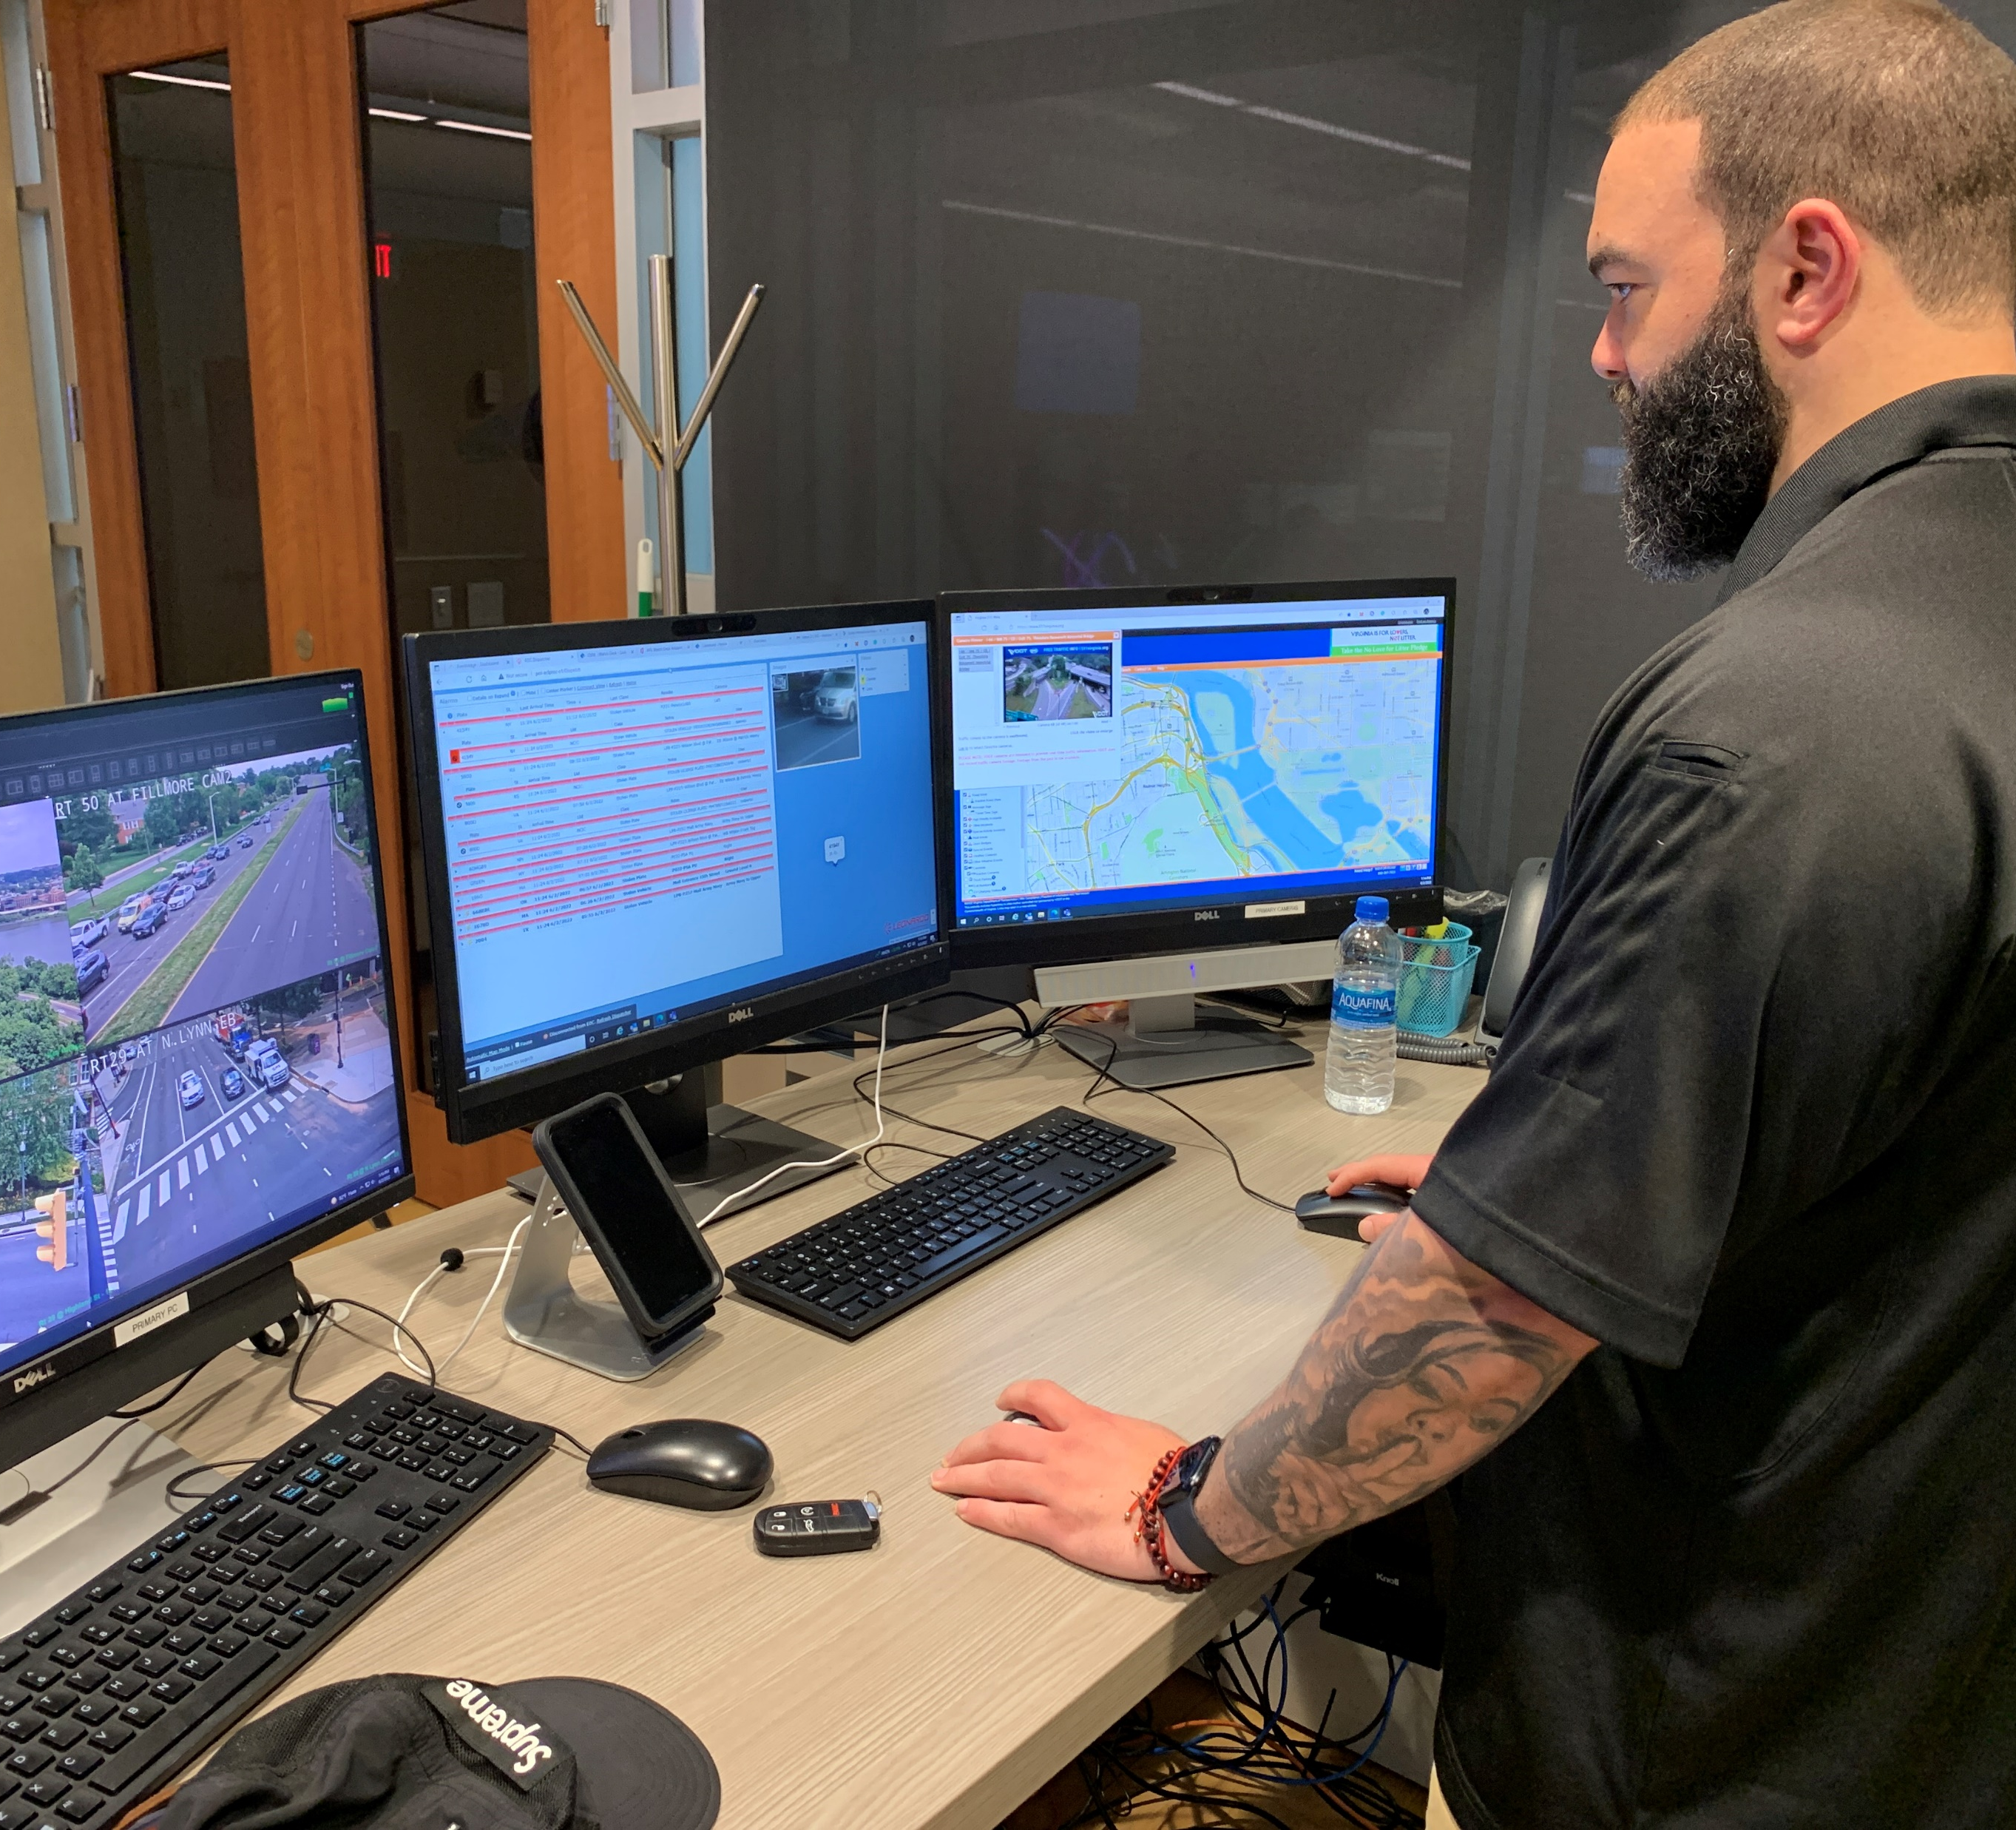
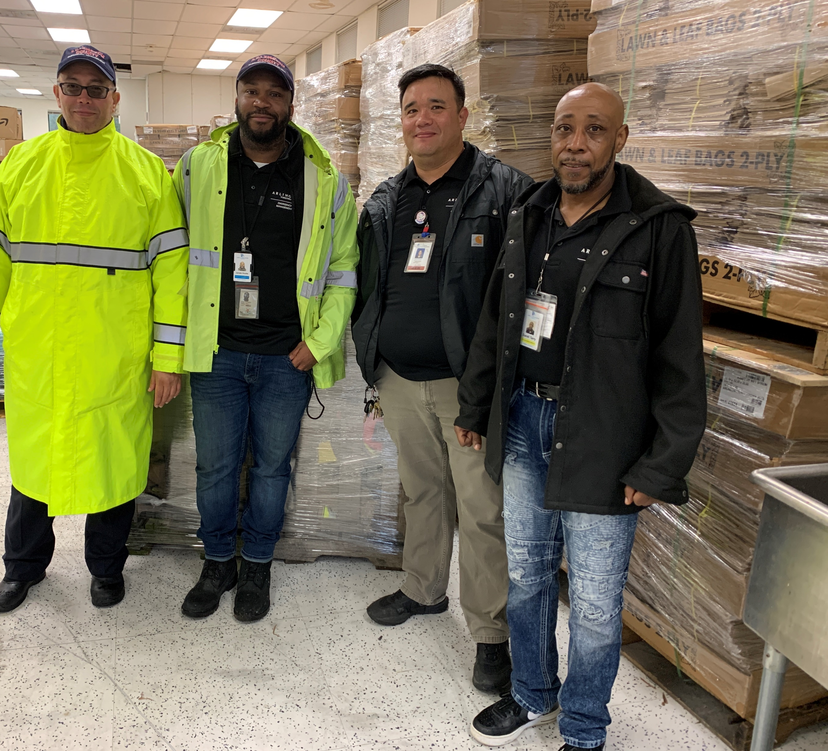
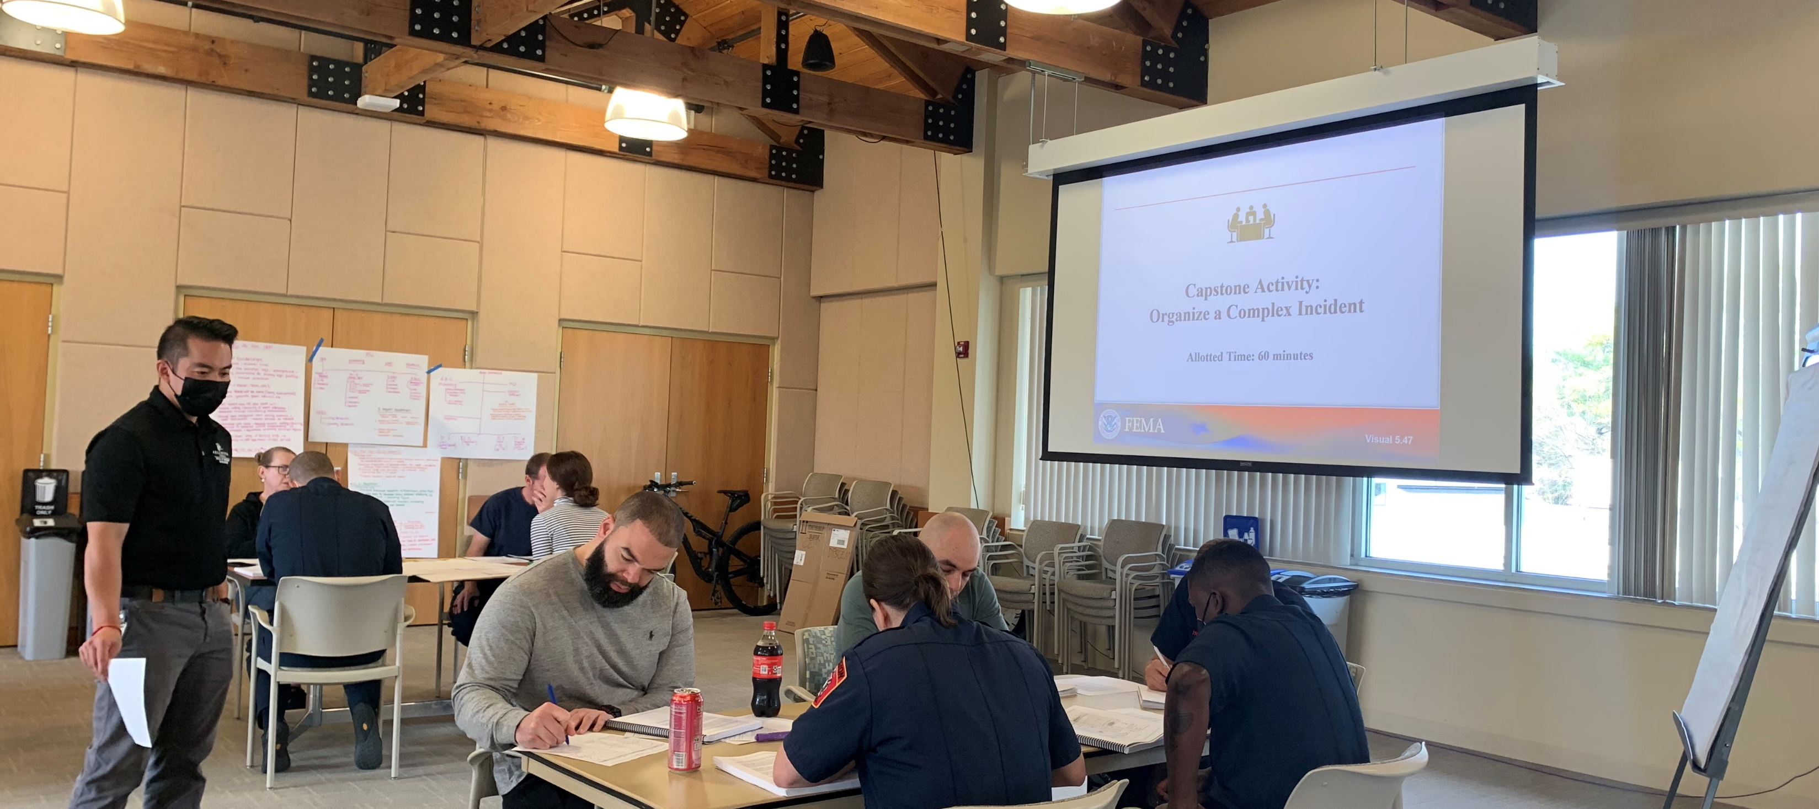
Emergency
Management
Notes:
The second is the Emergency Management Division, which consists of three teams/subdivisions:
Planning, Training, & Exercises: This team writes the complex plans that make sure we know what to do when an emergency strikes. They also give us training and practice on what to do to help us understand the plans.
Logistics/Warehouse: This team is responsible for storing and inventorying all our resources and getting them to where they need to go.
Watch Desk: This team is our open-source intelligence and monitoring unit and provides us with daily updates.

Slide 8
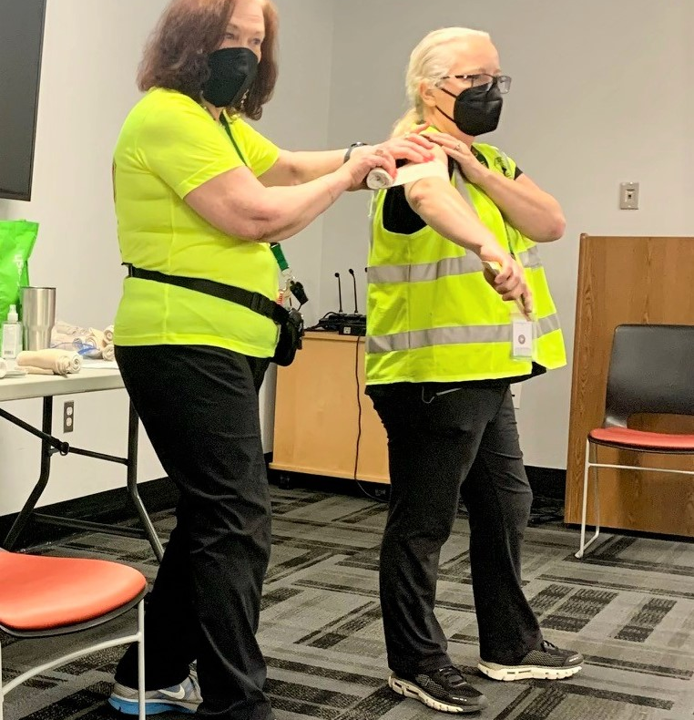
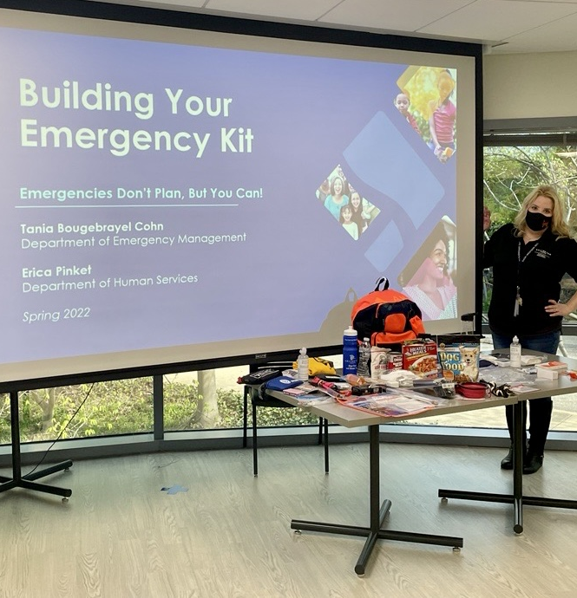
Integrated Programs
Notes:
And thirdly, the Integrated Programs Division is responsible for volunteer coordination, communications, resilience, human resources, finances, and community outreach and education—such as events like this! They integrate with other departments as well as the community and are the ones who make sure the public is informed during an emergency.
They’re also the ones who translate the complex plans into easy-to-understand information, and we’re also the ones who coordinate with other departments to get our team – and the public – resources like funding for programming or to put together big events like the Public Safety Block Party or the County Fair. We’re essentially the bridge between emergency management concepts and the public.

Slide 9
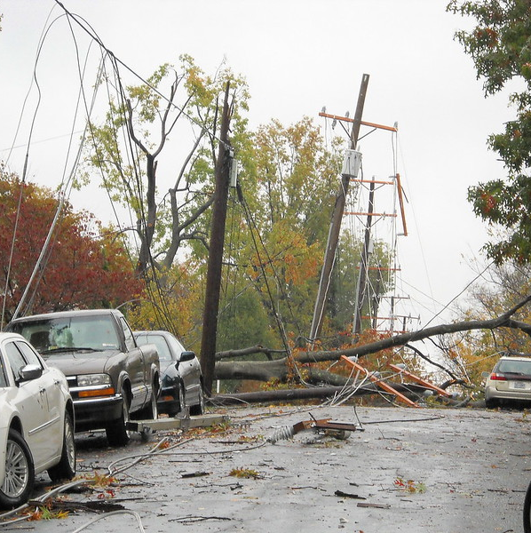
What do you think constitutes an emergency?
Notes:
ASK AUDIENCE: What do you think constitutes an emergency? (Take 3-4 answers)
Emergencies are often sudden, urgent, usually unexpected, and require immediate action. They can range from man-made events, to natural disasters like hurricanes, to pandemics, to cyber incidents.

Slide 10
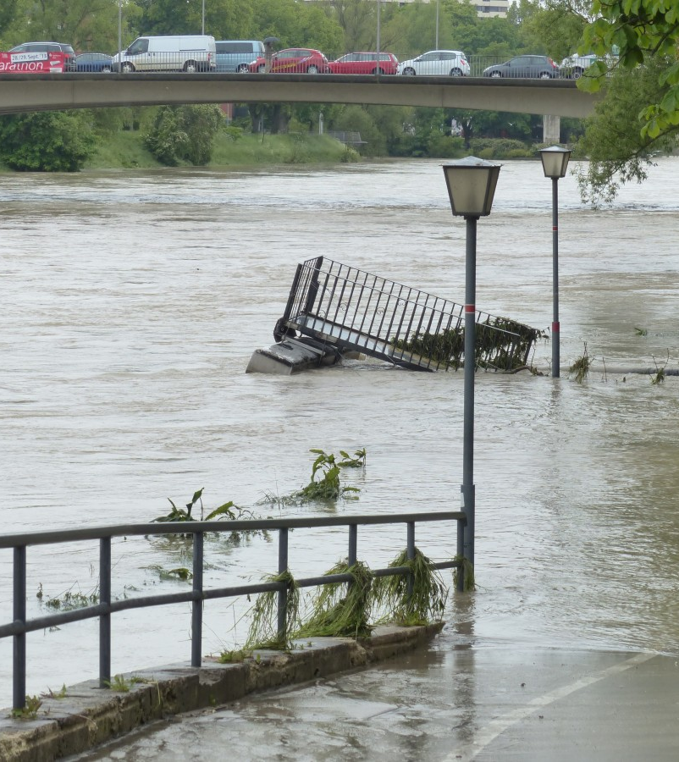
Threats and Hazards In Arlington
Flooding
Winds
Man-made events
Inter-jurisdictional emergencies (e.g., evacuation of DC)
Notes:
Part of our job entails evaluating threats or hazards that are more likely to occur in Arlington – so we can better prepare for them. These differ between every jurisdiction in the nation. For example, Honolulu probably prepares for volcanoes, LA considers earthquakes – and we consider the ones below:
Flooding, winds, man-made events, and inter-jurisdictional events like mass evacuations from DC to Arlington.

Slide 11
Trends and Evolutions in Threats and Hazards
More frequent extreme weather
More man-made events
Civil unrest and political discord
Technology considerations
Notes:
As emergency management professionals, we must stay informed of trends and best practices in the field. Trends at the local, state, and national levels impact emergency management practices. In Arlington – and across our nation - we have seen increased natural disasters such as flooding and winter storms. These are not only increasing in frequency but in intensity as well. So not only are localities facing more extreme weather, but the likelihood that weather will bring damage and require emergency management coordination is rising too. We have also seen an increase in man-made disasters such as cyber-attacks and active shooter situations, as well as rising threats of domestic extremism and political unrest.
Combine these – more extreme weather, more unrest, more coordination – and suddenly, you realize that emergency managers are being increasingly asked to plan for and coordinate events within events. A memory that will forever stand out to me as perfectly illustrative of this was when our team was coordinating the County’s pandemic response while at the same time responding to the January 6 insurrection, while at the same time coordinating potential sheltering for extreme cold. Events, within events, within events, with the same small but mighty team.

Slide 12
Challenges
Doing more, but with less
Coordination and communication
Notes:
Challenges in emergency management These trends are also challenges – we’re increasingly being asked to do more in our jobs in both frequency and complexity.
Yet at the same time we’re being asked to do more, we’re also being asked to do it with less.
Resource management is one of our greatest local, state and national challenges. This challenge feels more acute now, in 2023, as the world sits on the brink of a potential recession. Resource management focusing on funding and staffing impacts our office and offices across the state. It can be challenging to allocate the necessary resources to maintain preparedness and response capabilities.
Another major challenge is ongoing coordination and communication between our office, our internal and external partners, and the community at large. During an emergency, it is crucial to have clear communication and coordination between all responders, agencies, and the community. We joke in our field that the first time we exchange business cards shouldn’t be in our emergency operations center – and the first time the community learns about us shouldn’t be after a disaster has struck. Maintaining that proactive dialogue and engagement is an ongoing challenge, particularly as we navigate that challenge of doing more with less.

Slide 13
What are we doing to address them?
Proactive partner coordination (seminars, training, meetings)
Community engagement and resilience-building
Leverage Technology
Effective emergency planning
Look to other industries
Notes:
To address these challenges, we have developed several strategies. One of the most important is communication and coordination. We work closely with our first responders, including the police and fire departments, human services and nonprofit partners, neighboring jurisdictions, and schools to ensure that we can respond quickly and effectively during an emergency. An example of this is our award-winning APS-ACG school response symposium series. We bring together school leaders, public safety staff to discuss and plan for coordinated response to acts of violence in schools.
Community engagement is another critical strategy. We encourage residents to prepare their own emergency kits, develop family communication plans, and stay informed during emergency situations. We also provide training and educational resources to help residents prepare for emergencies. Our two keynote program areas are: our CERT volunteer group, which helps us prepare for and respond to emergencies, such as staffing our COVID-19 testing events and teaching our Until Help Arrives classes that educates people how to save lives in emergencies like mass shootings. And our Community Resilience Group, CARRT, which brings together community leaders to help the County identify strategies to collaboratively build sustainable emergency preparedness and resilience with a focus on underserved groups.
Technology and innovation are essential in emergency management. The region uses advanced technology to monitor and track weather patterns, identify potential threats, and communicate with first responders – this is housed in our Watch Desk, which uses technology to maintain situational awareness of threats and hazards and share that information with our partners and with you, our residents. That’s why signing up for Arlington Alert is so important – it’s our way to quickly get information to you.
Educational collaboration and partnerships are another critical strategy to enhancing our effectiveness and efficiency. We actively cultivate relationships with other EM agencies and other industries, like floodplain management, supply chain, housing and human services, public transportation planning… you name it. We want to learn how they work, the sorts of contingencies they consider, so we can adopt them into our system-level preparedness ,response and recovery plans. We seek a holistic and forward-leaning view of our resources and barriers to accessing them, as well as how we can work better to serve you, our residents. We’ve got to learn from other industries if we hope to bring them to the table in our work.
Finally, an effective emergency management plan is critical. We have developed a comprehensive emergency management plan that outlines our response protocols, communication strategies, and resource allocation. We review and update this plan regularly to ensure it is up-to-date and reflects the latest trends and best practices.

Slide 14
What can YOU do?
Subscribe to Arlington Alert (ArlingtonAlert.com)
Make an emergency plan with your loved ones
Keep emergency supplies in your car and in your home
Volunteer with CERT and CARRT
Help your neighbors and contacts
Notes:
So I’ve spent a lot of time talking about what we do – but I want to close by taking a moment to talk about a few things you can do to build a more prepared household and community.
First – sign up for Arlington Alert at arlingtonalert.com. This is the free customizable messaging service we use to share alerts about hazardous weather, major events and more.
Second – talk with your loved ones about an emergency plan. How will you keep in touch if you’re separated in an emergency? Where can you meet, and do the kids know how to get there or who to call if you’re not available?
Third – keep emergency supplies in your home and your car. Drinking water, non-perishable food, blankets, medicine – that sort of thing.
Fourth – consider volunteering with our CERT or CARRT groups. You’ll learn preparedness skills and also meet an amazing group of your neighbors.
Fifth – help others be prepared. Knock on your neighbor’s door to offer to help shovel their walkway. Give someone a call during a heat wave to see if they need anything. Encourage others to sign up for Arlington Alert. Whatever the support you lend – something as simple as a two minute check in can go a long way in helping someone’s physical and mental well-being. We’re all in this together and all play a role in building a prepared community.

Slide 15
THANK YOU!
Learn more:
ReadyArlington.com
Ready.gov

