Slide 1
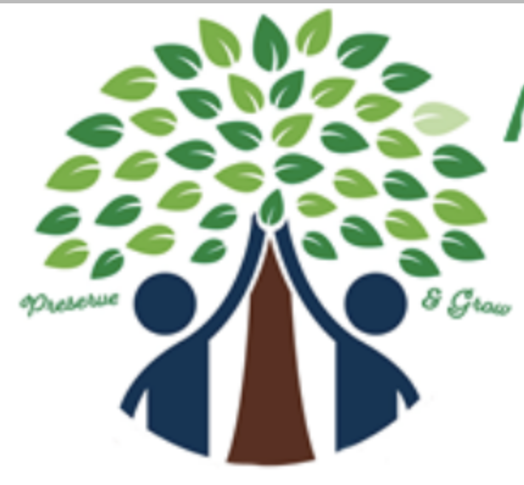
Arlington Tree Action Group
ATAG
Overview for Bluemont Civic Association
January 26, 2022
Kit Norland
Susan Land

Slide 2
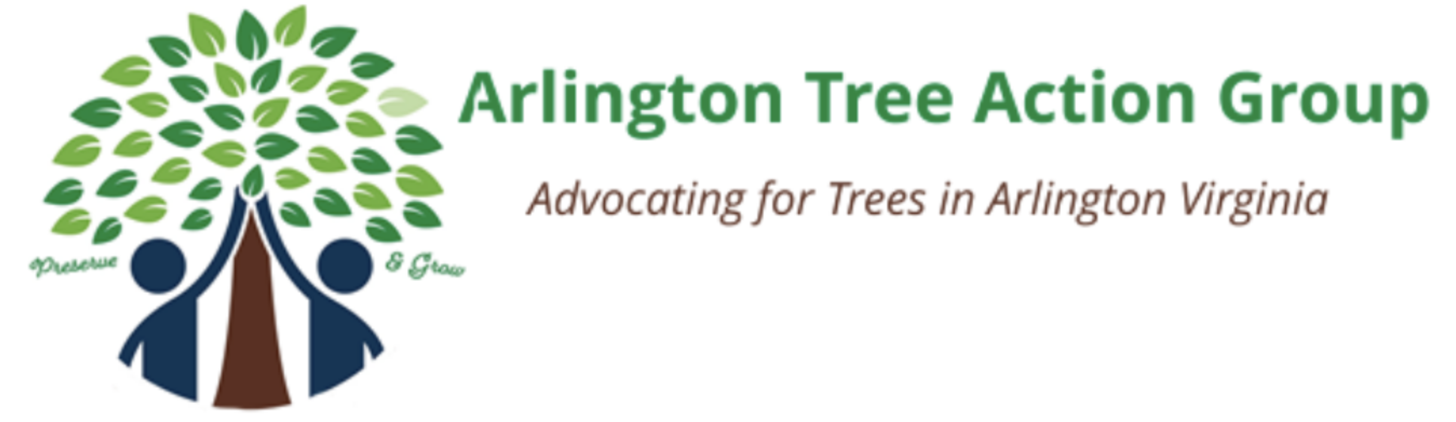
Arlington Tree Action Group (ATAG) is a network of citizens working to preserve and grow Arlington, Virginia’s urban forest to keep Arlington green and fulfill the Vison stated in the County’s Urban Forestry Master Plan*.
* Urban Forestry and Natural Resources Master Plan to be updated May 2022
www.arlingtontreeactiongroup.org

Slide 3
ATAG Organization
Started in 2016
All volunteer, grassroots organization
Run by a core group of members
500+ members on our mailing list
Members serve on:
  Arlington Commissions (Forestry and Natural Resources Commission)
  Task Forces (Langston Blvd Planning Commission, Gulf Branch Advisory Group, etc),
  Civic Federation Committees (Parks & Recreation, Environmental Affairs),
  and are active in their civic associations
Networked with organizations such as:
  Chesapeake Bay Foundation
  Eco-Action Arlington
  NAACP Environment and Climate Justice Committee
  Arlington/Alexandria Tree Stewards
  League of Conservation Voters

Slide 4
Recent Key Actions
Public Land:
Donaldson Run Stream Restoration – lobbied the county to use modern, eco-friendly methods
Testified at the Reed School construction hearings on behalf of neighbors about tree destruction
Testified at VDOT hearings to protect trees and RPA during W&OD bike path widening
Joined EcoAction and Arlington’s Climate Change, Energy and Environment Commission (C2E2) in urging County Board to declare a Climate Change Emergency
Urban Heat Islands and Trees – Asked the County Board to make this a priority

Slide 5
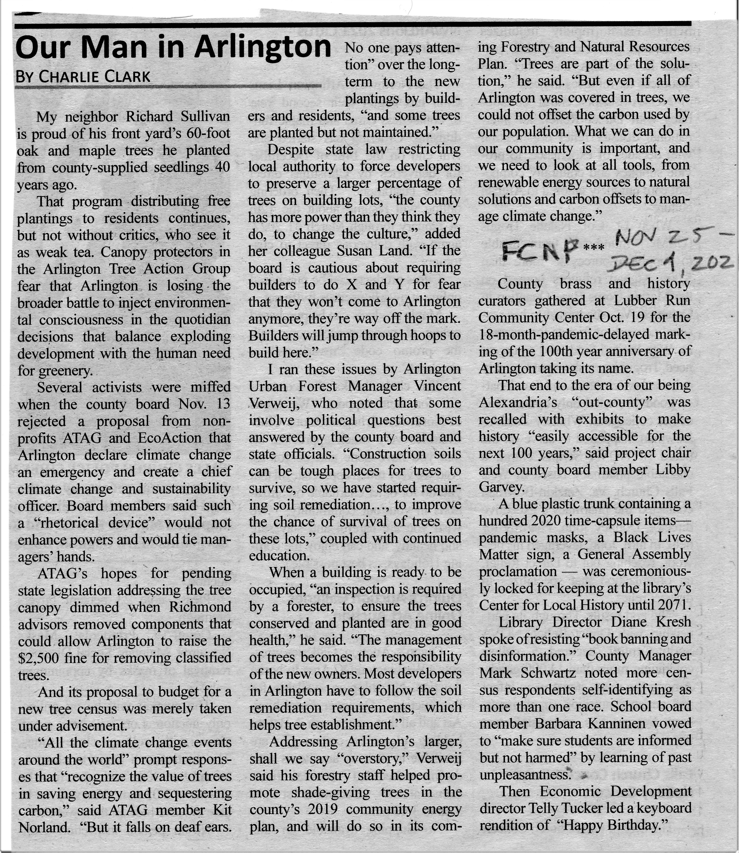
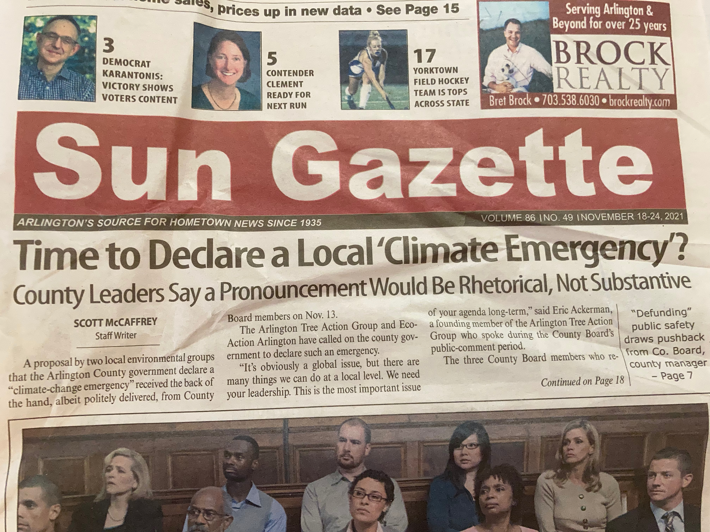
Recent Press

Slide 6
Recent Key Actions
Private Land:
Single family in-fill development - Educate neighbors and encourage developers to preserve existing mature trees while building new houses
Advocated to the County Board for more (and better trained) Urban Foresters
Participated in a public collaborative on tree preservation with the Civic Federation Environment Committee – series of 3 public collaborative meetings – developers, citizens, key stakeholders
ATAG monitors the Stakeholder Advisory Group researching Trees as BMP for Stormwater Retention (HB520)
Use Itree.org to calculate the annual stormwater absorption and CO2 mitigation for individual trees on private lots

Slide 7

Neighborhood Tree Canopy Actions
Worked with neighbors, developers, and the county to save mature trees at the following properties:
  6593 Williamsburg Blvd. – two mature trees saved
  3260 N Ohio St. – Dawn Redwood destruction, construction in an RPA
  1027, 1028, 1031 N Edgewood St. – neighbors concerned about flooding, loss of mature trees
  2539, 2540, 2549 N Ridgeview Rd. – neighbors concerned about flooding, loss of mature trees
  608 N Garfield St. – mature tree saved
  3577 N Powhatan St. – two mature trees saved
  4010 20th St. N – mature tree removed by developer
  2437 N Utah St. – neighbors concerned about flooding, loss of large specimen tree
  5059 36th St. N – several mature trees saved
  6318 35th St. N – large specimen tree saved
  2807 24th Rd. S – neighbors concerned – loss of 40 trees
  4605 26th St. N – neighbors concerned about flooding due to tree loss
  1700 N. Potomac – shared tree with county, saved
  6404 Washington Blvd – 100 year old notable Chestnut tree

Slide 8
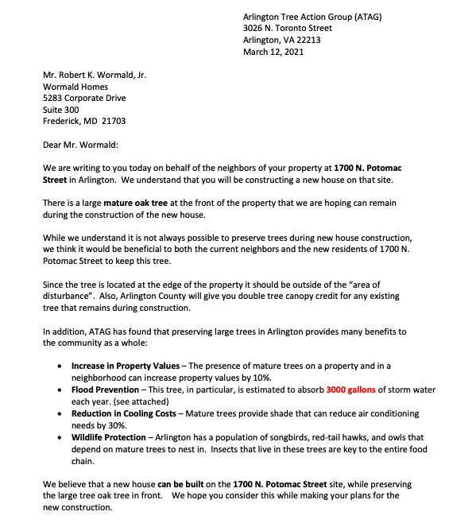
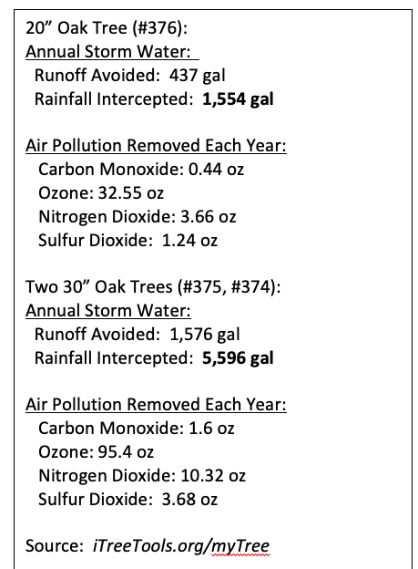
Neighborhood Tree Canopy Actions
Sample letter:
Sample tree valuation:

Slide 9
Free Yard Signs!
https://arlingtontreeactiongroup.org/contact-us/

Slide 10
Resources
ATAG
  www.arlingtontreeactiongroup.org
Calculate Tree Value:
  www.iTreeTools.org
RPA (Resource Protection Area) Map:
  https://gis.arlingtonva.us/gallery/map.html?webmap=0cac5571900245dca864391daee8f008
Property Ownership (current and previous):
  https://propertysearch.arlingtonva.us/Home/Search
Building Permits:
  https://permits.arlingtonva.us
Land Records and Recent Sales (requires registration with the county):
  https://landrec.arlingtonva.us/public/

