Slide 1
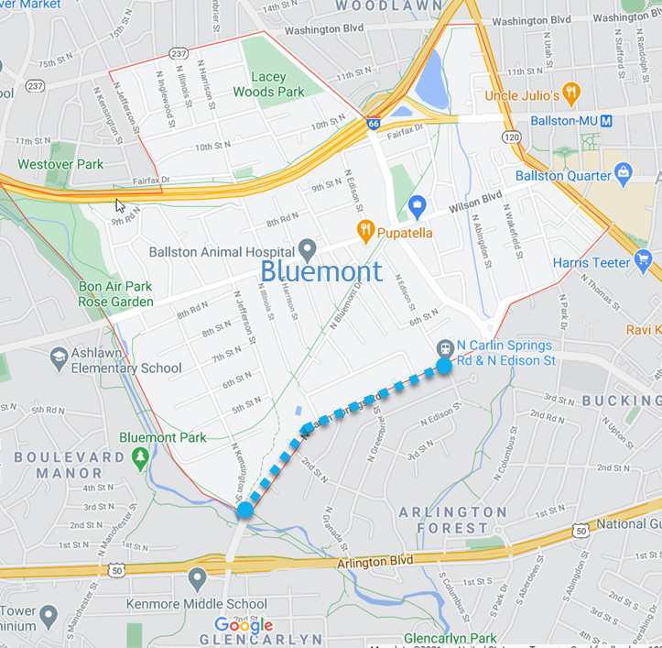
N. Carlin Springs Road Task Force https://www.bluemontcivic.org/northcarlinsprings.php Objective: Provide a comprehensive, data driven report to the BCA executive board and members with the recommendations of the task force

Slide 2
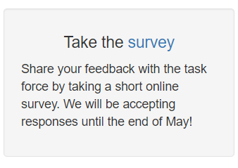
* Create dedicated web page for all task force findings/information * Engage the community through an online survey * Present report with recommendations to the Bluemont Civic Association * Engage DES and the county resource with recommendations
Approach

Slide 3
N. Carlin Springs Road Task Force
May
Presented survey/webpage and engaged with Arlington Forest Citizens Association at their May membership meeting
April
October
January
June
Draft recommendations presented and agreed on by task force members
Survey opened to Arlington Forest and Bluemont residents
Survey closed with 92 responses gathered
First meeting and site walk
02
04
08
10
06
2020 December
2021 December
2021
Q4
Q1
Q2
Q3
Q4
01
03
05
07
09
11
BCA Meeting
February
April
May
August
November
N. Carlin Springs Task Force Established
Second and third meeting; Second site walk
Passed flyers out
to Bluemont
residents
Passed flyers out
to Arlington
Forest
residents
Survey report presented to task force members
Present recommendations at the BCA general membership meeting

Slide 4
1-10 scale question averages 1. 7.86 Additional marked crosswalks 2. 7.70 Wider/ADA compliant sidewalks 3. 7.40 Street lighting Carlyle (dark sky compliant) 4. 7.10 Curb extensions with median island/refuge with marked crosswalk 5. 6.95 Median streetscaping (when possible) 6. 6.48 Bike lanes/bike facility 7. 6.24 The addition of one or more stop lights 8. 6.16 Some form of a road diet * 48 comments were submitted out of the 92 survey responses. Speeding was the issue mentioned the most and possibly reducing the speed limit was mentioned multiple times. People had some concern about the effectiveness of the yellow RFB and would rather see red pedestrian activated lights. More respondents liked the idea of a road diet than disliked; 2 comments did not want any form of diet and about 6-7 did like the idea. 5 responses made mention that a crossing was needed at the Arlington Forest Club, and another mentioned that there should be crossings at all major bus stop intersections. Reducing vehicle speeds to make the road safer for pedestrians and cyclists while ensuring traffic continues to flow properly so that there aren’t cut through traffic issues. More traffic enforcement was also mentioned multiple times.
Report Highlights
92 responses received from Bluemont and Arlington Forest

Slide 5
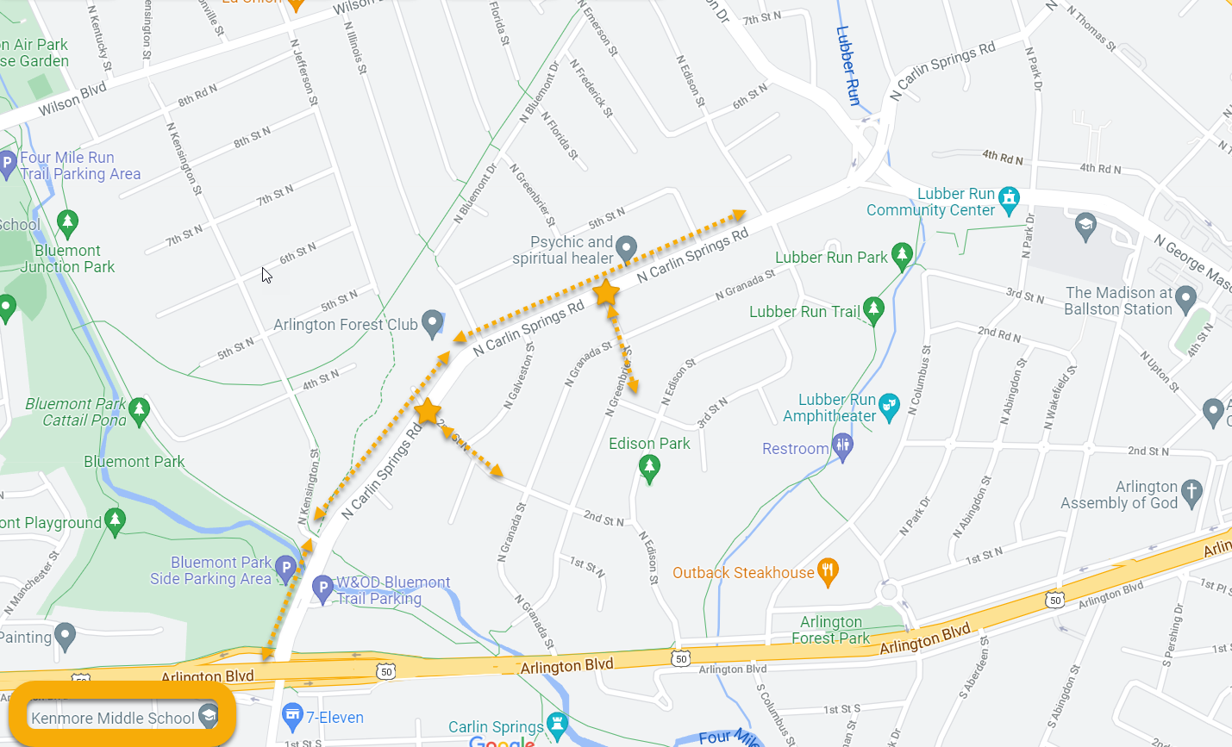

Slide 6
Allow for the safe, orderly flow of bicyclists, motor vehicles, pedestrians, and transit. Motion to implement traffic calming and pedestrian safety measures on N. Carlin Springs Road between the intersection of N. Edison Street and N. Kensington Street in the Bluemont neighborhood to make it safer and more accessible for all modes of transportation. • The addition of marked ADA compliant crossings, median island refuge with curb extensions, and streetscaping when possible, at the below intersections (at a minimum) o 2nd Street North and N. Jefferson Street o N. Greenbrier Street • Arlington County to take over the management of streetlighting and convert to dark sky compliant Carlyle style lights • Request the county consider lowering the speed limit to 25 mph from 30 mph as part of the county Vision Zero effort Next steps: Request the county to work collaboratively with the BCA to maximize public participation and input into the further consideration, design, implementation, and evaluation of traffic by involving neighborhood residents, local business, neighboring civic associations, and other potentially impacted parties. Request the county consider implementing improvements as part of a Vision Zero, repaving, or NC project effort. Also, have the county consider using a demonstration project to pilot changes before fully implementing. Include these recommendations in the Bluemont Neighborhood Conservation Plan.
Task Force Recommendations

