Slide 1
The Arlington Historical Society
David Pearson
President, Arlington Historical Society
March 27, 2024
Bluemont Civic Association

Slide 2
Arlington Historical Society
Mission: Improve our community by building knowledge of our diverse history
Non-profit 501.3(c)
Currently funded entirely by membership dues and donations
Hosts free events to the public
Website and social media

Slide 3
The Arlington Historical Museum
Oldest schoolhouse (1893)
Acquired in 1961
Exhibits from Native America to 9/11
Model classroom c. 1900, (visitors can ring the school bell!)
1805 South Arlington Ridge Road
Open FREE Sat & Sun, 1-4 pm
Group tours FREE upon request

Slide 4
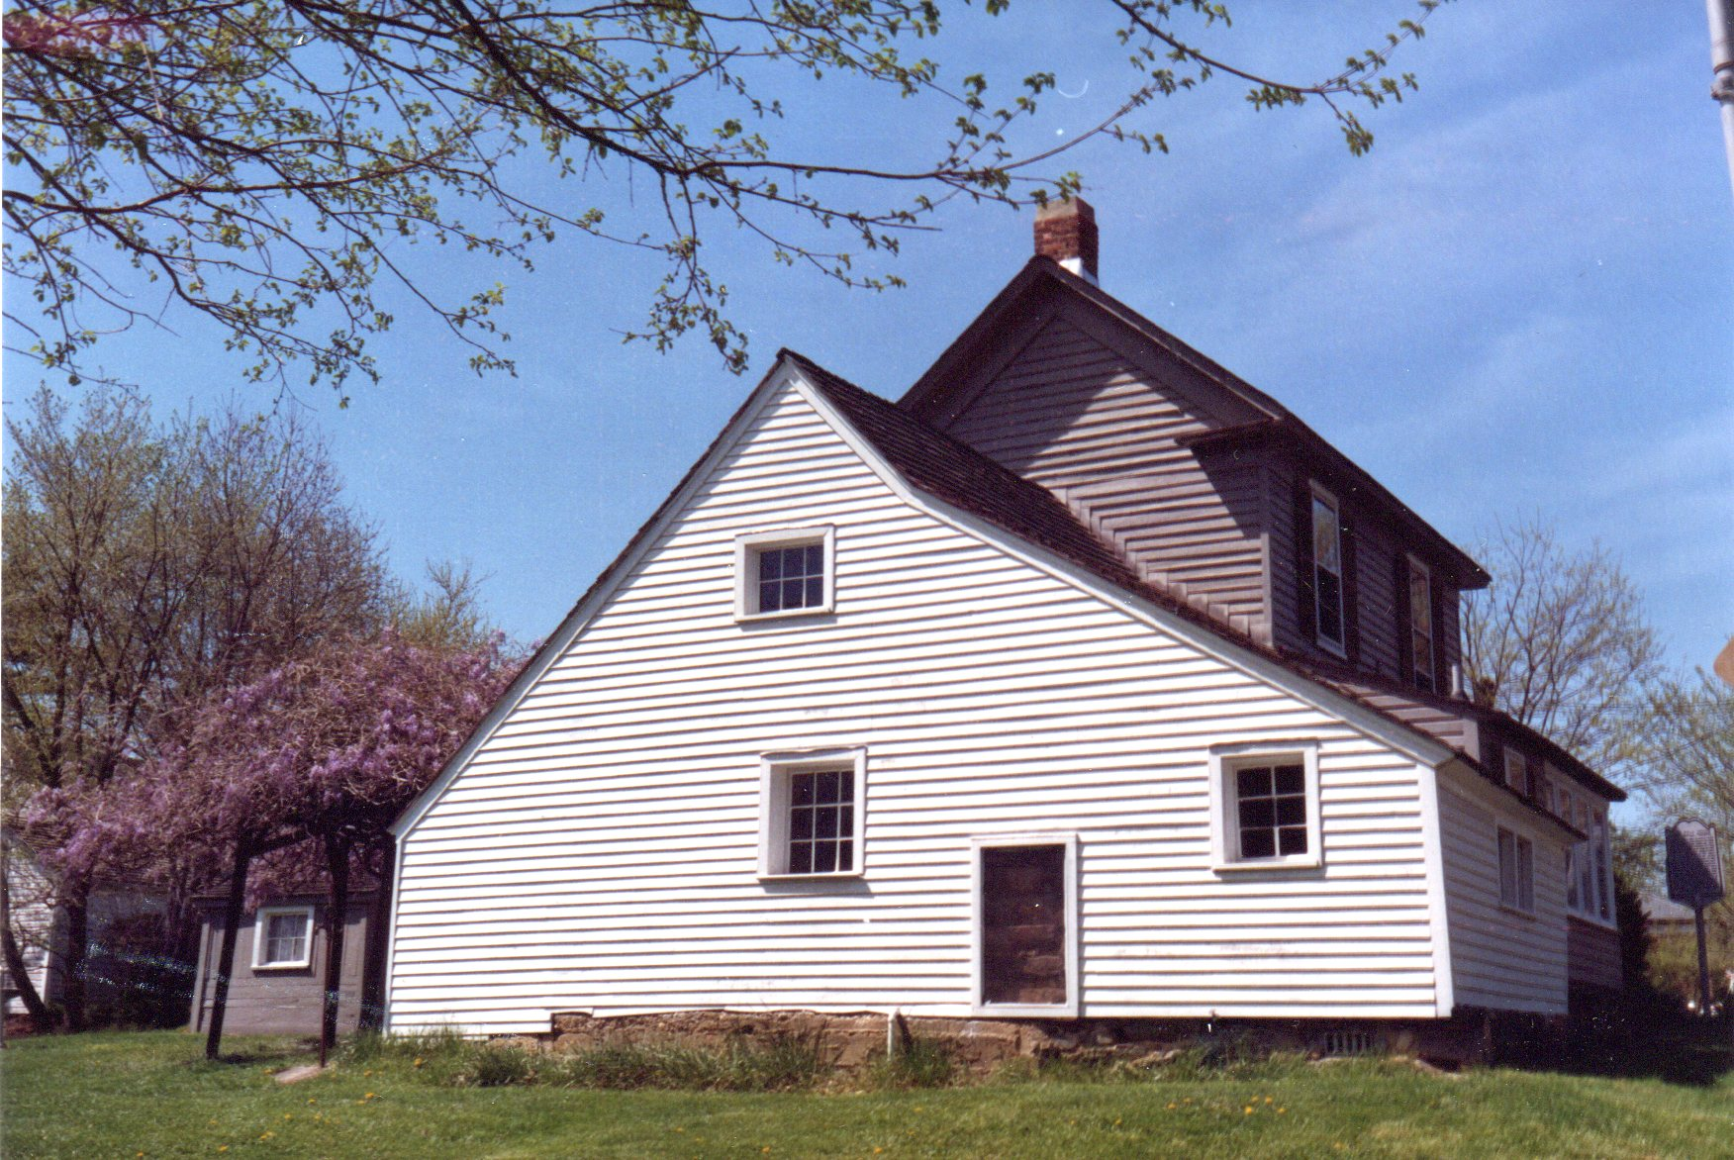
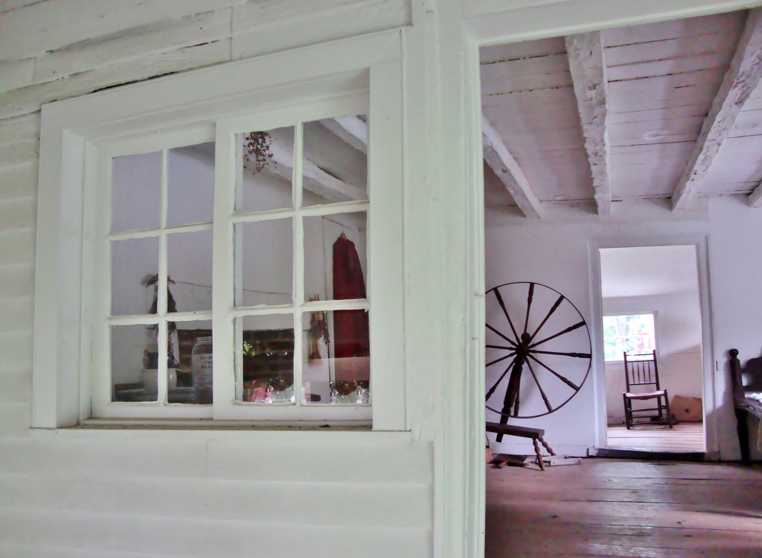
The Ball-Sellers House Museum
Donated to AHS in 1975
County’s oldest structure, built c.1750
Existing 2-story addition built 1883
Microcosm of Arlington history
Open FREE!
Saturdays Apr-Oct 1-4 pm
Free group tours upon request

Slide 5
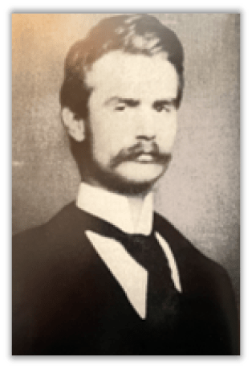
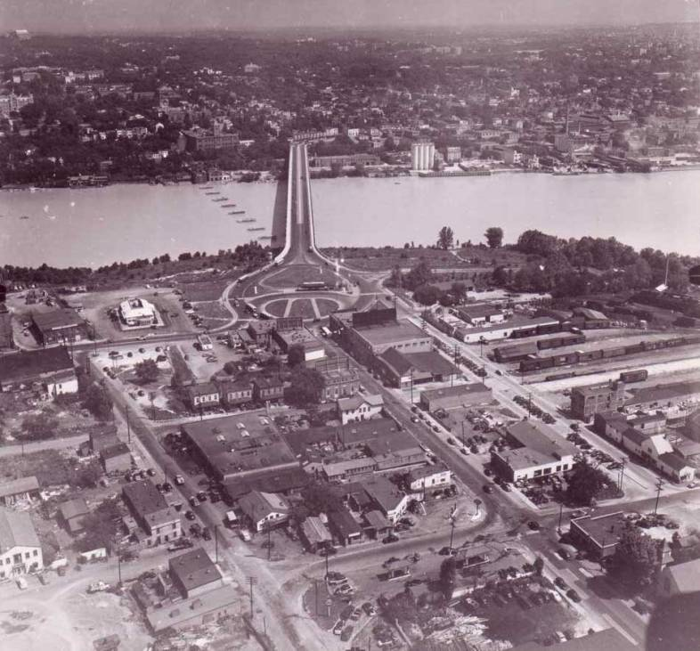
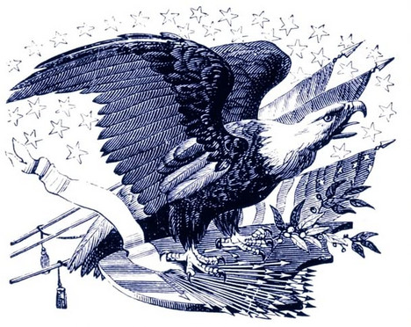
Free Monthly Public Events Year Round
May 9: Shotgun Justice: A Crusader Against Crime and Corruption with journalist and author Michael Lee Pope
Apr 11: The Rambler: The Washington Star’s Local Reporter in Arlington: 1912-1927 with author and AHS Board Member Marty Suydem
Jul 11: Revolutionary Arlington with former HALRB chair and member and current AHS volunteer and tour leader Kevin Vincent
Jun 13: Window Seat to Arlington’s Riverfront with journalist and retired Smithsonian Air & Space Magazine researcher Roger Mola

Slide 6
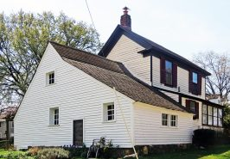
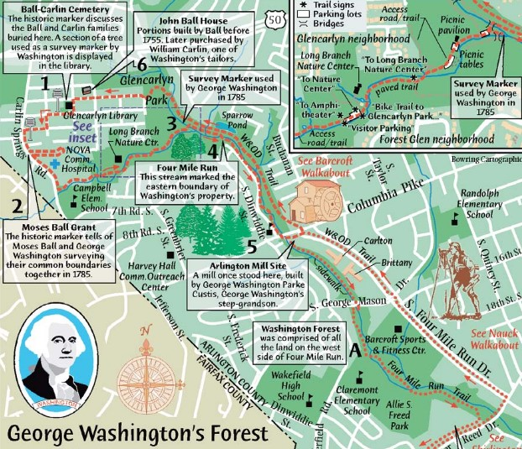
Other Special Events
Apr 6: Ball-Sellers House: Sounds and Sights of a Colonial Famhouse Season opening of Arlington’s oldest extant structure with music of the colonial era
Apr 20: Ball-Sellers House Spring Celebration with the Glencarlyn Community Garden Celebrate Colonial Gardening with hands-on activities
Apr 28: An Ordinary Hero: A Conversation with Joan Mulholland Co-Sponsored event, hosted by Mount Olivet United Methodist Church and St. Mary’s Episcopal Church
April 27th: George Washington’s Forest History Walk Guided walking tour of George Washington sites in Arlington

Slide 7
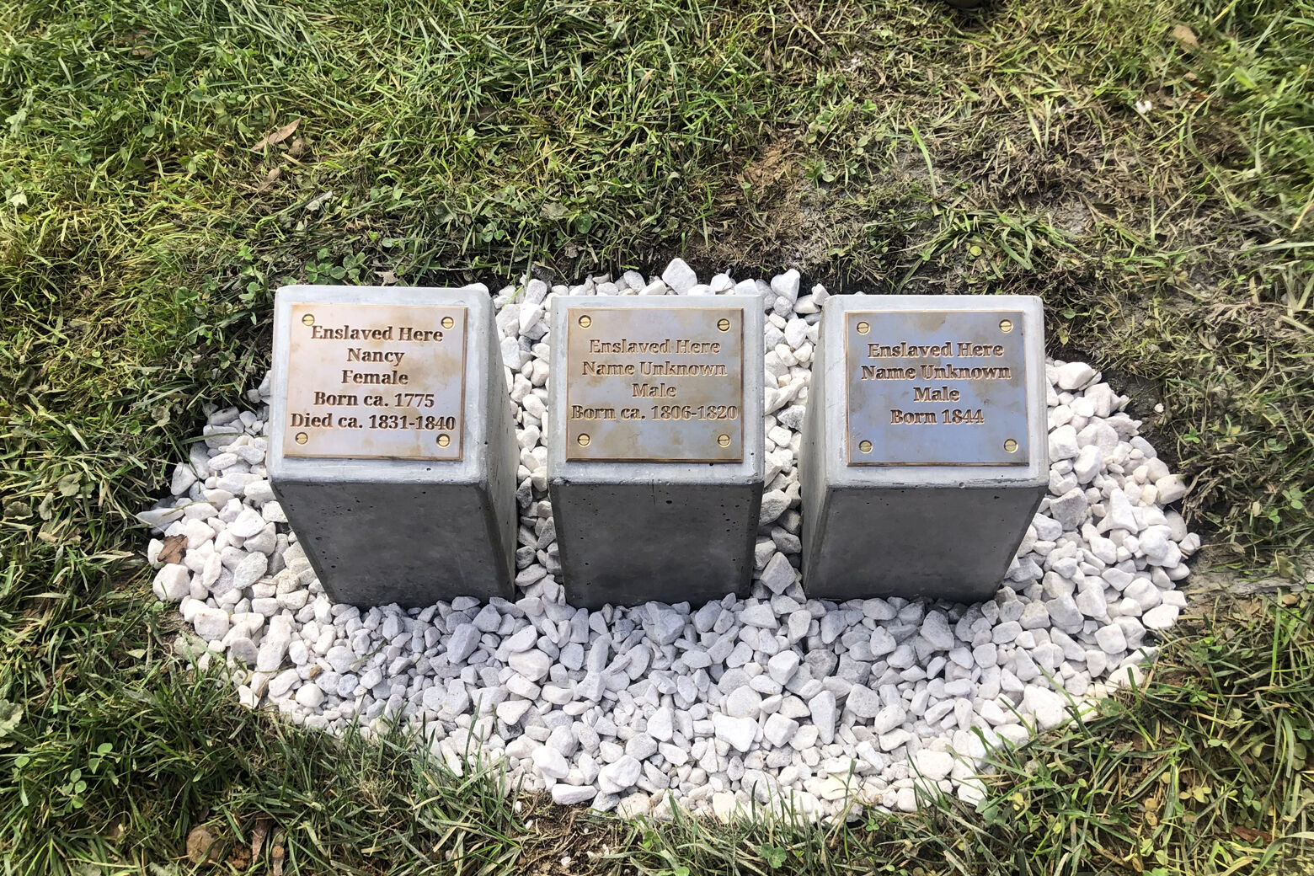
Special Project: Memorializing the Enslaved
In partnership with the Black Heritage Museum of Arlington
Recover history of the enslaved
Share their stories
Commemorative stones near property
Interactive online map on AHS website
In classrooms for all ages
Placed first 3 markers at the Ball-Sellers House last October

Slide 8
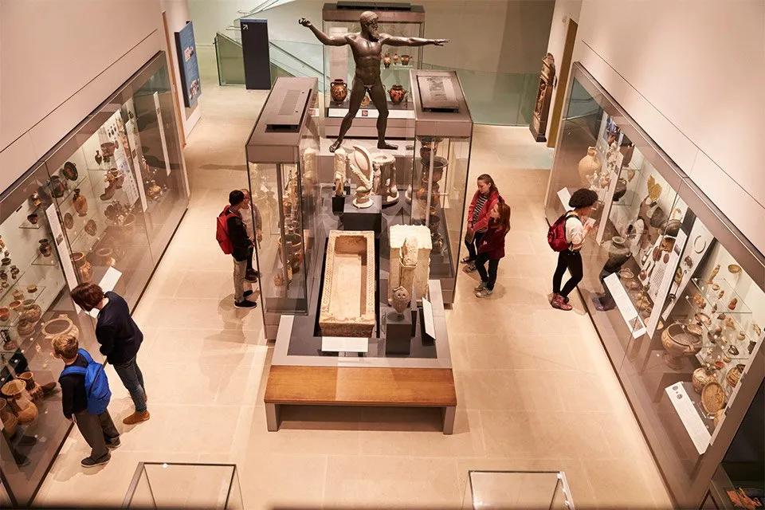
Transforming the Arlington Historical Museum
Refurbish and preserve
Renovate inside
Transform exhibits to better reflect all of Arlington
Notes:
The Museum is the premier destination to learn about Arlington’s unique place in history.
Museum exhibitions document Arlington’s diversity, tell stories representing all, and connect visitors with Arlington historical sites.
Museum building serves as a vibrant, accessible community space.

Slide 9
Serving the Community in Many Ways
Museums
Free museum tours
Schools
Museum-in-a-box
Social Media
On this day in Arlington history
Community
Meeting space
Teaching aids
VA 250
Exhibitions
Demonstrations
Re-enactments
Classroom resources
“What’s It” Wednesday
News, fun facts
History hikes
Notes:
Free museum tours for groups and schools upon request
Museum-in-a-box artifacts in schools
Mini-exhibits at community events
Free guest lecturers on local history
Free educational resources for teachers and Arlington students of any age
Partnering with others for commemorative events

Slide 10
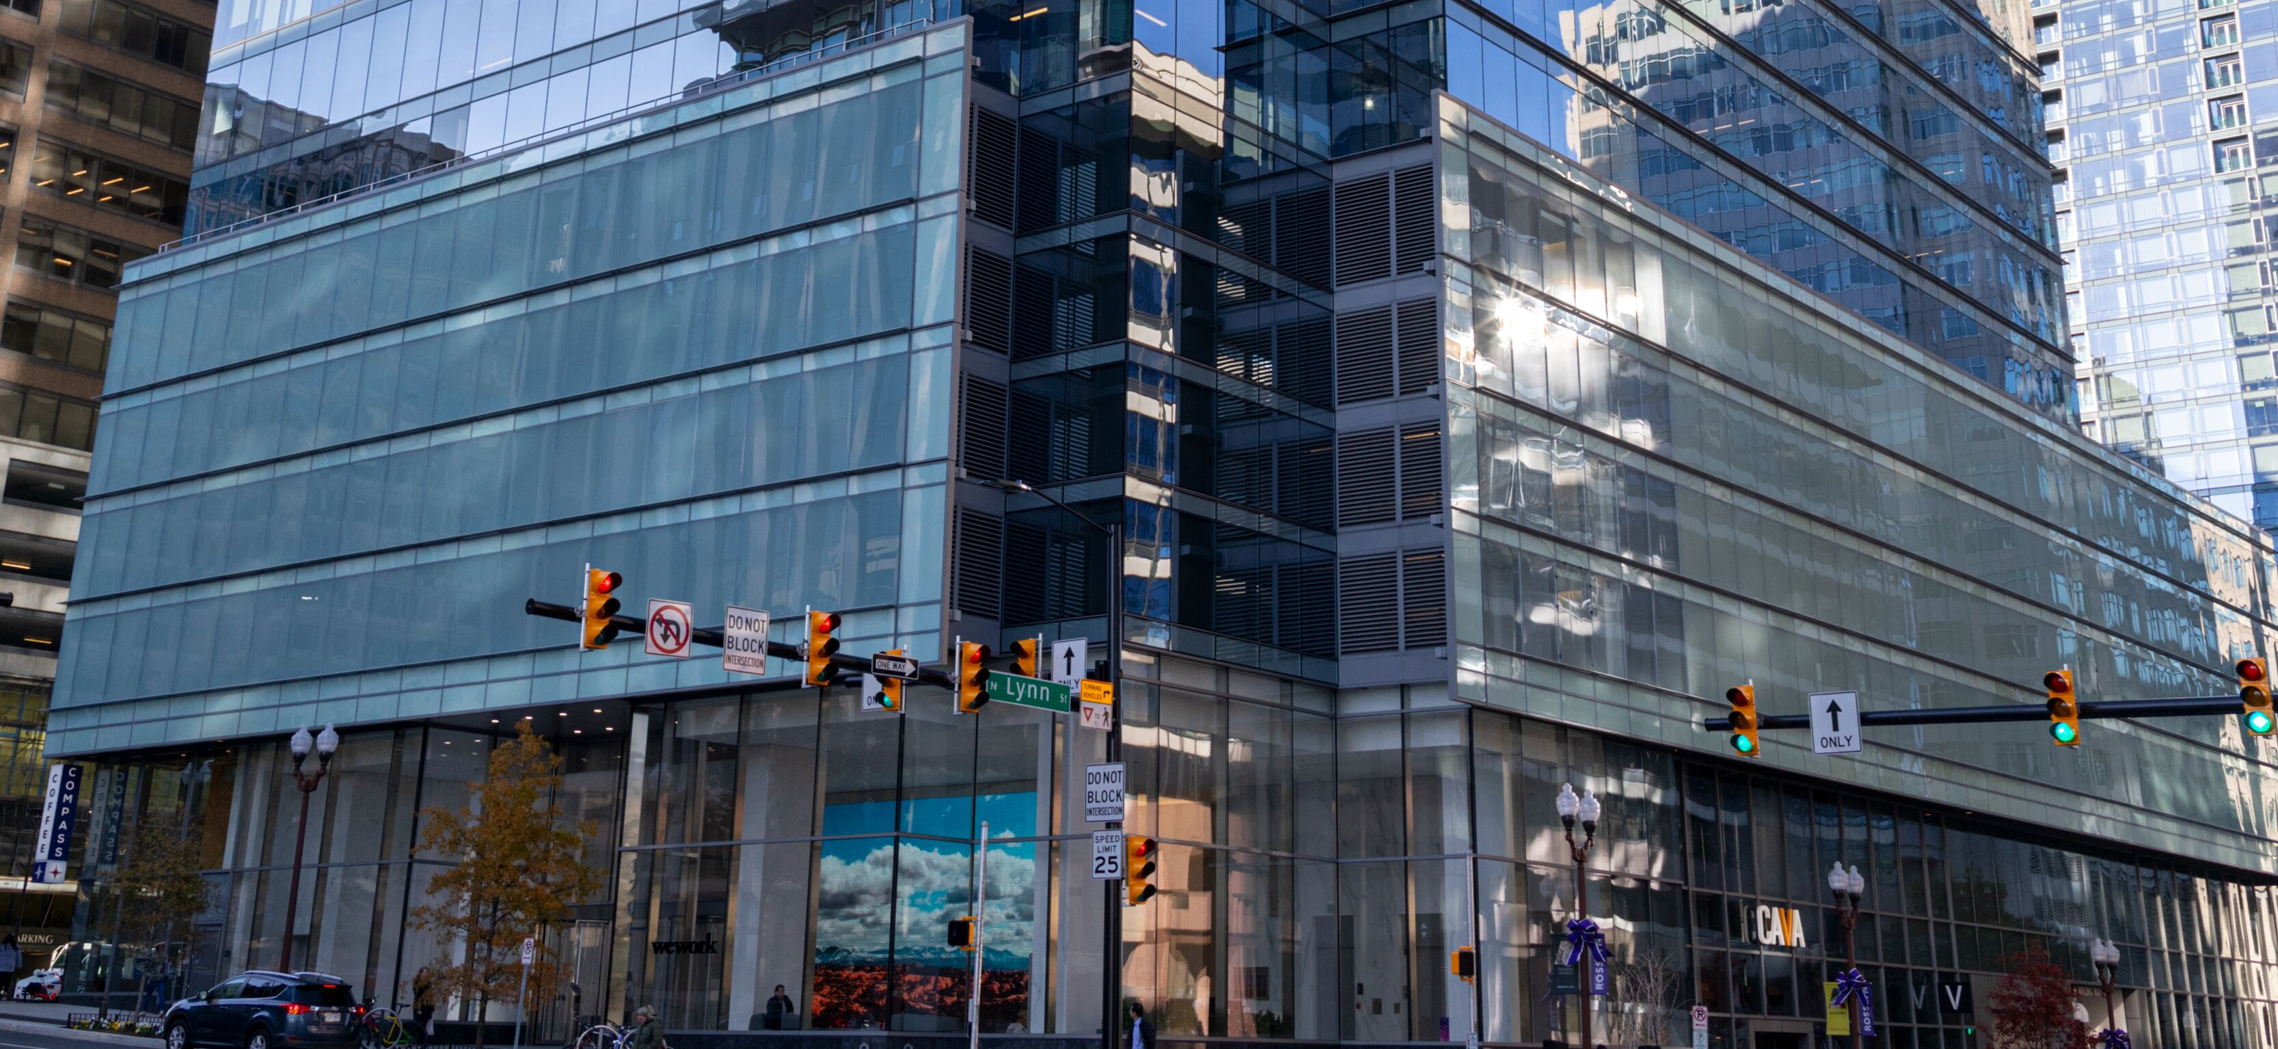
AHS and the Future
Build a stronger community by improving knowledge of our shared history.
Ensure history of all Arlington is preserved and shared through outreach, events, and publications
Transform exhibit space and provide access for all to Arlington Historical Museum: fund raising!

Slide 11
What Can AHS Do For You?
Present history on a topic you are interested in
Display artifacts related to your interests
Partner with you at your community events
Offer group tours at both museums or history walks in your community
Help you document your history

Slide 12
What Can You Do to Help the Arlington Historical Society?
Become a member: membership starts at $35. Get monthly email, quarterly newsletter, annual Arlington Historical Magazine, and 10% discount on any AHS purchase.
Donate artifacts of Arlington history. Help us tell Arlington’s story.
Donate financial support for the work of AHS and preservation of our two museums.
Volunteer with AHS in any of our wide variety of opportunities. We’ll help you find something you’ll find rewarding and fun.

Slide 13
Thank you!
For more information, go to our website:
ArlingtonHistoricalSociety.org
Like us on Facebook: Arlington Historical Society
Find us on Instagram: @ArlingtonHistory
Email: info@arlingtonhistoricalsociety.org

